Slide 1
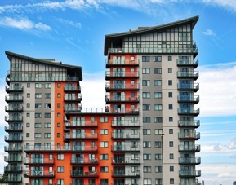
Clearing the Air:
A Coalition’s Guide to Going Smokefree
Onjewel Smith
Southern States Strategist
Traci Kennedy
Midwest States Strategist

Slide 2
Where to Start?
Notes:
The toughest part of a smokefree campaign is figuring out where to start…

Slide 3
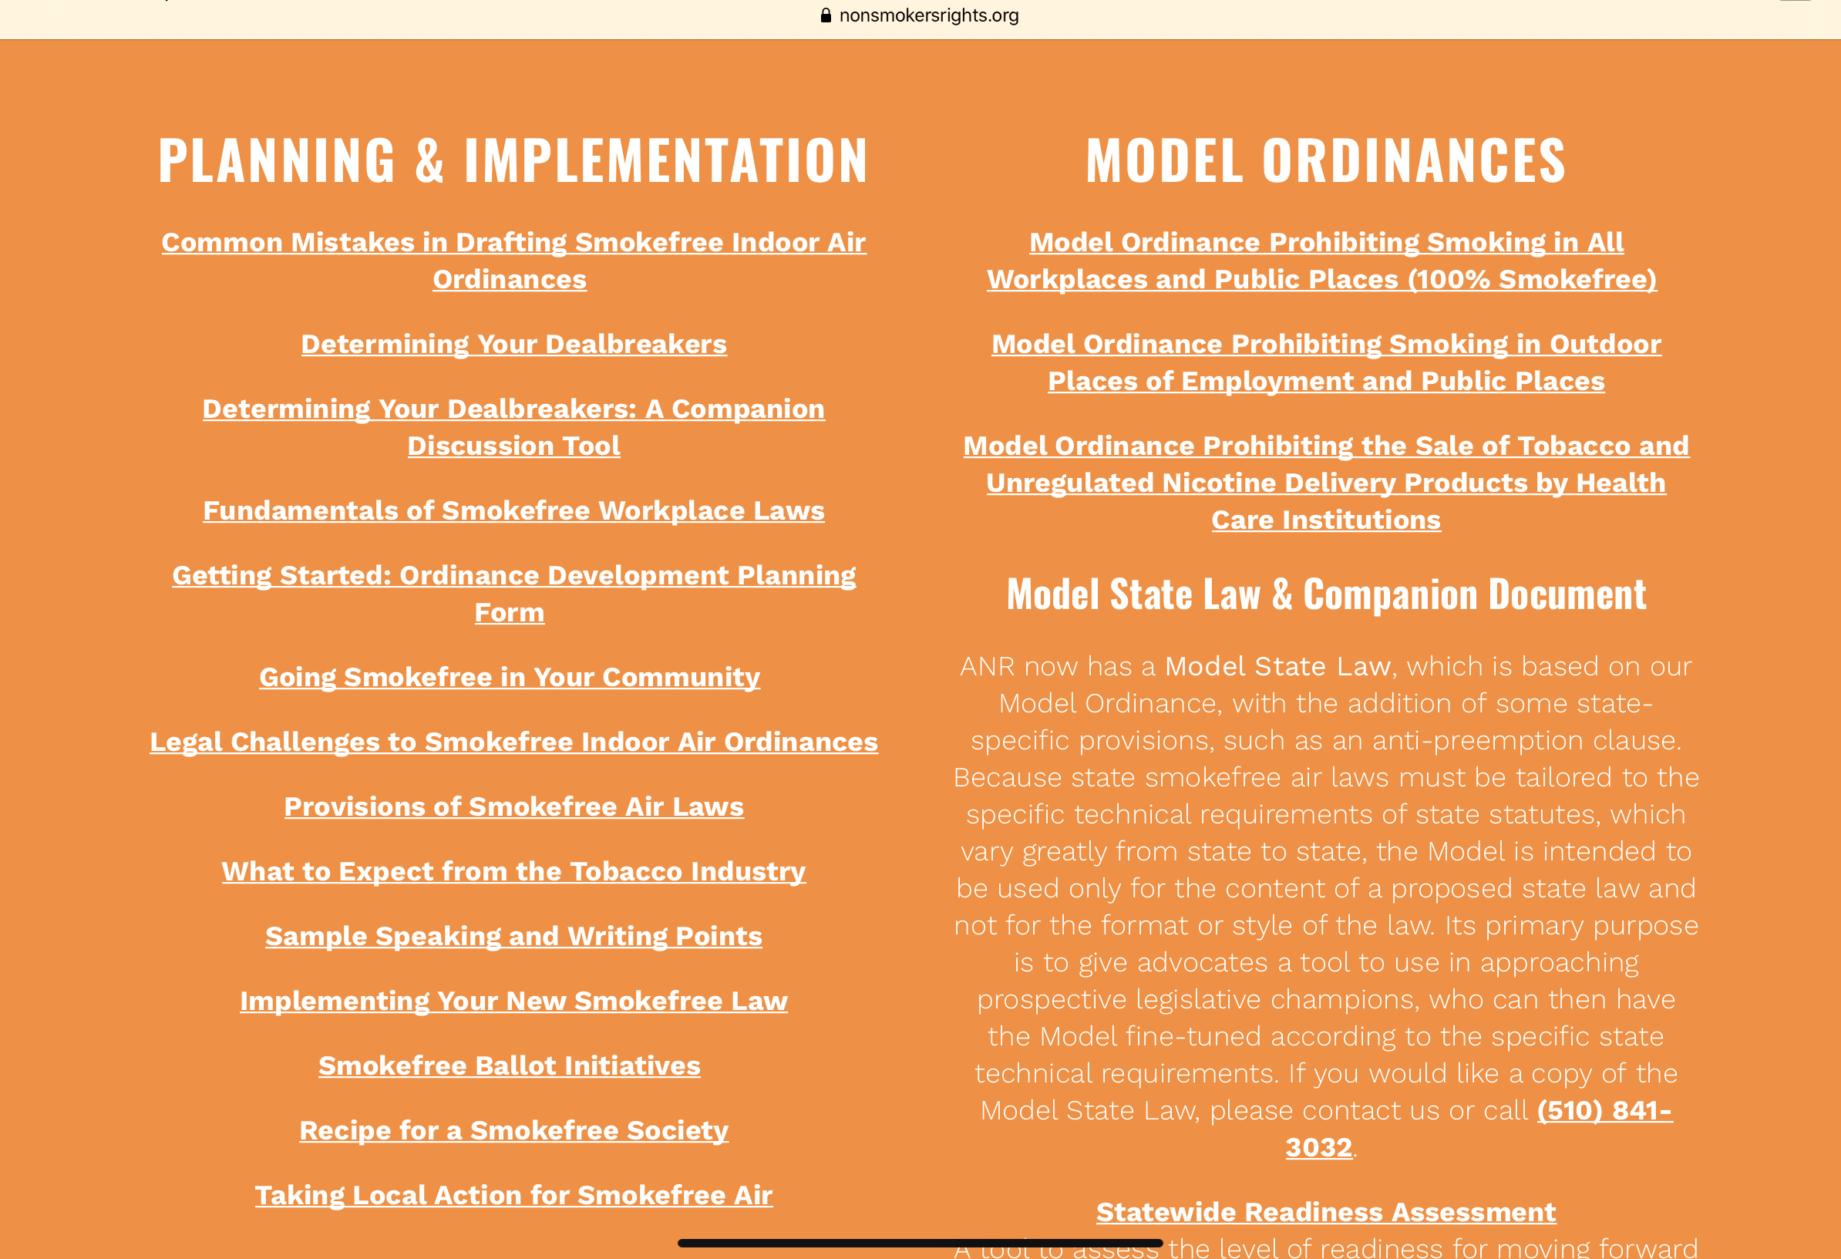
ANR Campaign Tools and Resources:
https://nonsmokersrights.org/overview

Slide 4
STEPS TO SUCCESS: LOCAL POLICY CHANGE
ASSESS CURRENT POLICIES
FORM A COALITION
ESTABLISH A DATABASE OF SUPPORTERS
EDUCATE YOUR COMMUNITY
GAUGE COMMUNITY SUPPORT
DRAFT YOUR POLICY
FIND A GOOD SPONSOR
SHOW YOUR POWER!
IMPLEMENT
Notes:
STARTING STEPS
1 - ASSESS CURRENT LAWS
Find out what the current smokefree law is in your community. In some instances, there may be no laws whatsoever relating to smoking control, in which case you will be starting with a clean slate.
2 - FORM A COALITION
Strong coalitions accurately reflect your community. They are broad and inclusive, with meaningful representation of the people and organizations most affected by secondhand smoke in workplaces, multi-unit housing, and public venues.
3 - ESTABLISH A DATABASE OF SUPPORTERS
Establish a database of contact information, not only for coalition members and supporters, but also for community organizations, business leaders, public officials, and the media. Keep names, addresses, and email information in one database.
4 - EDUCATE YOUR COMMUNITY
Educate then legislate! Before going public with your proposed law, you need to lay the groundwork for it by conducting an effective public education campaign. Spend an adequate amount of time - several months to a year - on a public education campaign.
5 - GAUGE COMMUNITY SUPPORT
Public opinion surveys, asking residents how they feel about secondhand smoke and smokefree laws, are evidence of the demand for smokefree air and are persuasive to legislators when you approach them about a proposed law.
6 - DRAFT YOUR ORDINANCE
Consult our model ordinance. Pay particular attention to common mistakes when drafting the provisions of the ordinance. Agree on deal breakers at this stage (e.g., ventilation, hours or minors provisions, trigger schemes, etc.)
7 - FIND A GOOD SPONSOR
Find a city council member or board of health supervisor to sponsor the ordinance. Maintain communication with your sponsor and ensure that he or she will accurately represent your coalition goals.

Slide 5
Today’s Spotlight:
Assess the current situation
Educate on this issue
Advocate for policy change

Slide 6
Assess the Situation _____ Do Your Homework!
DO YOUR HOMEWORK
What is the current policy in your community?
What is the process for changing it?
How will this impact your community?
https://nonsmokersrights.org/overview
Notes:
Highlight a few key areas…

Slide 7
Coalition Readiness Assessment
DO YOUR HOMEWORK
Taking inventory
Coalition issues
Determining your dealbreakers
Community outreach & communication
Addressing the opposition
Outreach to local officials
Outreach to local media

Slide 8
DO YOUR HOMEWORK
What’s Your Current Policy Status?
What are the provisions of the law?
Check all that apply.
Cigar/Hookah Bars
E-cigarettes
Entrances to buildings
Freestanding Bars
Gaming Venues
Hotels/Motels
Membership Clubs (Elks, VFW...)
Municipal Buildings
Private Workplaces
Public Places
Outdoor Spaces (parks, beaches, patios...)
Restaurants
Tobacco Shops
Other:___________________________
What, if any, are exemptions to the law?
Check all that apply.
Bar Areas of Restaurants
Cigar/Hookah Bars
E-cigarettes
Freestanding Bars
Private Workplaces
Public Places
Restaurants
Separately Enclosed Smoking Rooms
Separately Ventilated Areas
Gaming Venues
Hotels/Motels
Membership Clubs
Other Exemption(s): ___________
What agency enforces the law?
Check all that apply.
Board of Health
City Administrator
Fire Department
Health Department
Law Enforcement
Other: __________________
Smoking Sign Required

Slide 9
Other Questions to Answer…
DO YOUR HOMEWORK
Which businesses will be impacted by new law?
(Local restaurants, bars, bowling allies, hotel/motels, etc.)
Who has the power to pass/adopt a new law
(city council, board of health, county commissioners)
Will this apply to incorporated or unincorporated cities w/in county?
What is the process for getting a new law passed?
(need a sponsor? How many readings? How many votes to pass?)
Are the any preemptive laws?

Slide 10
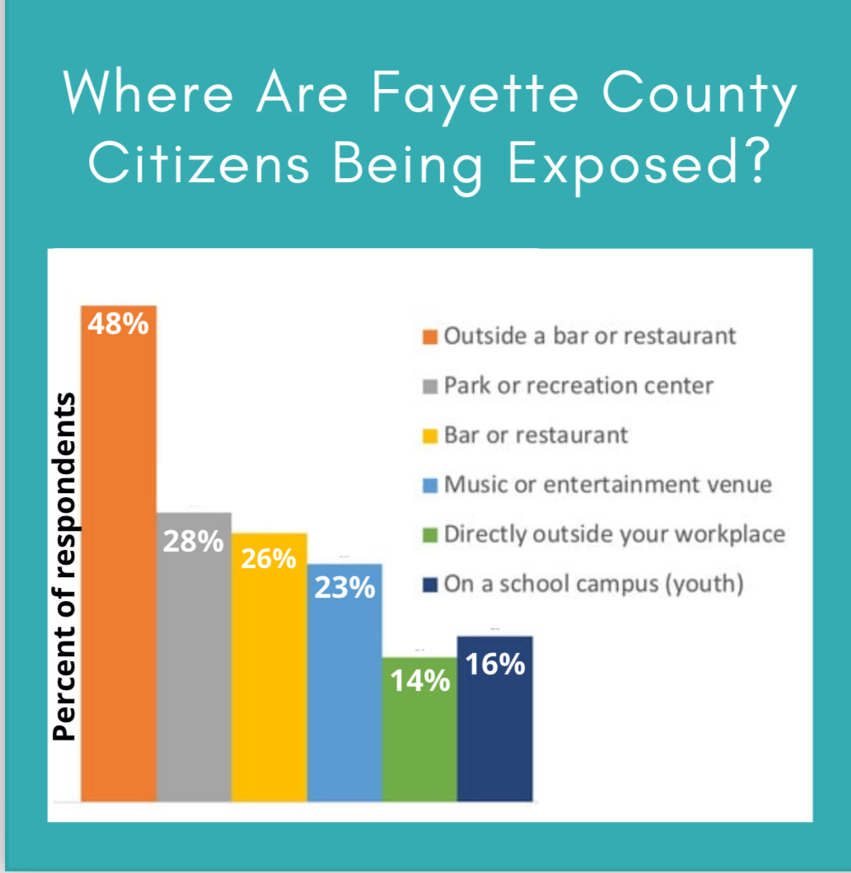
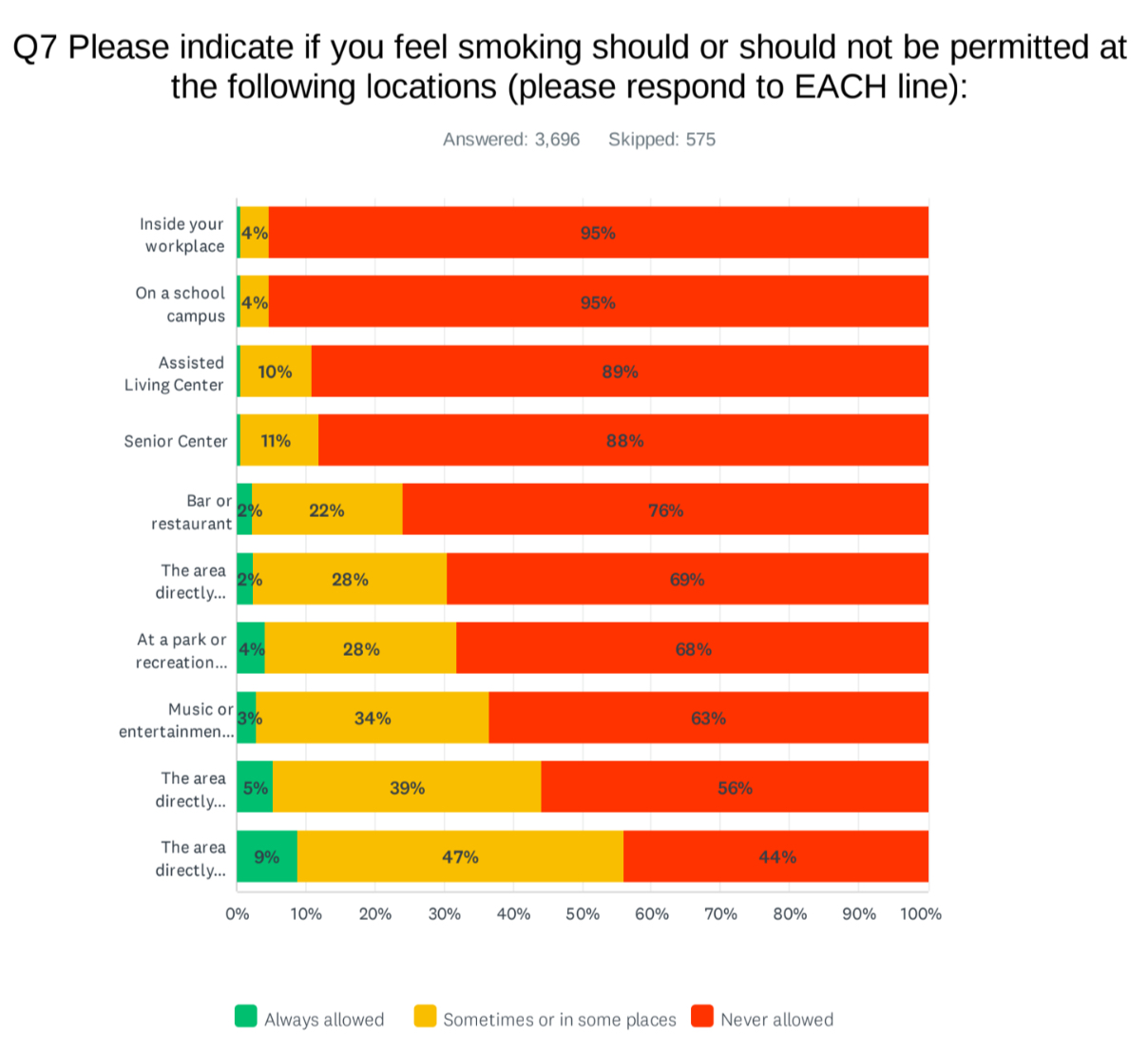
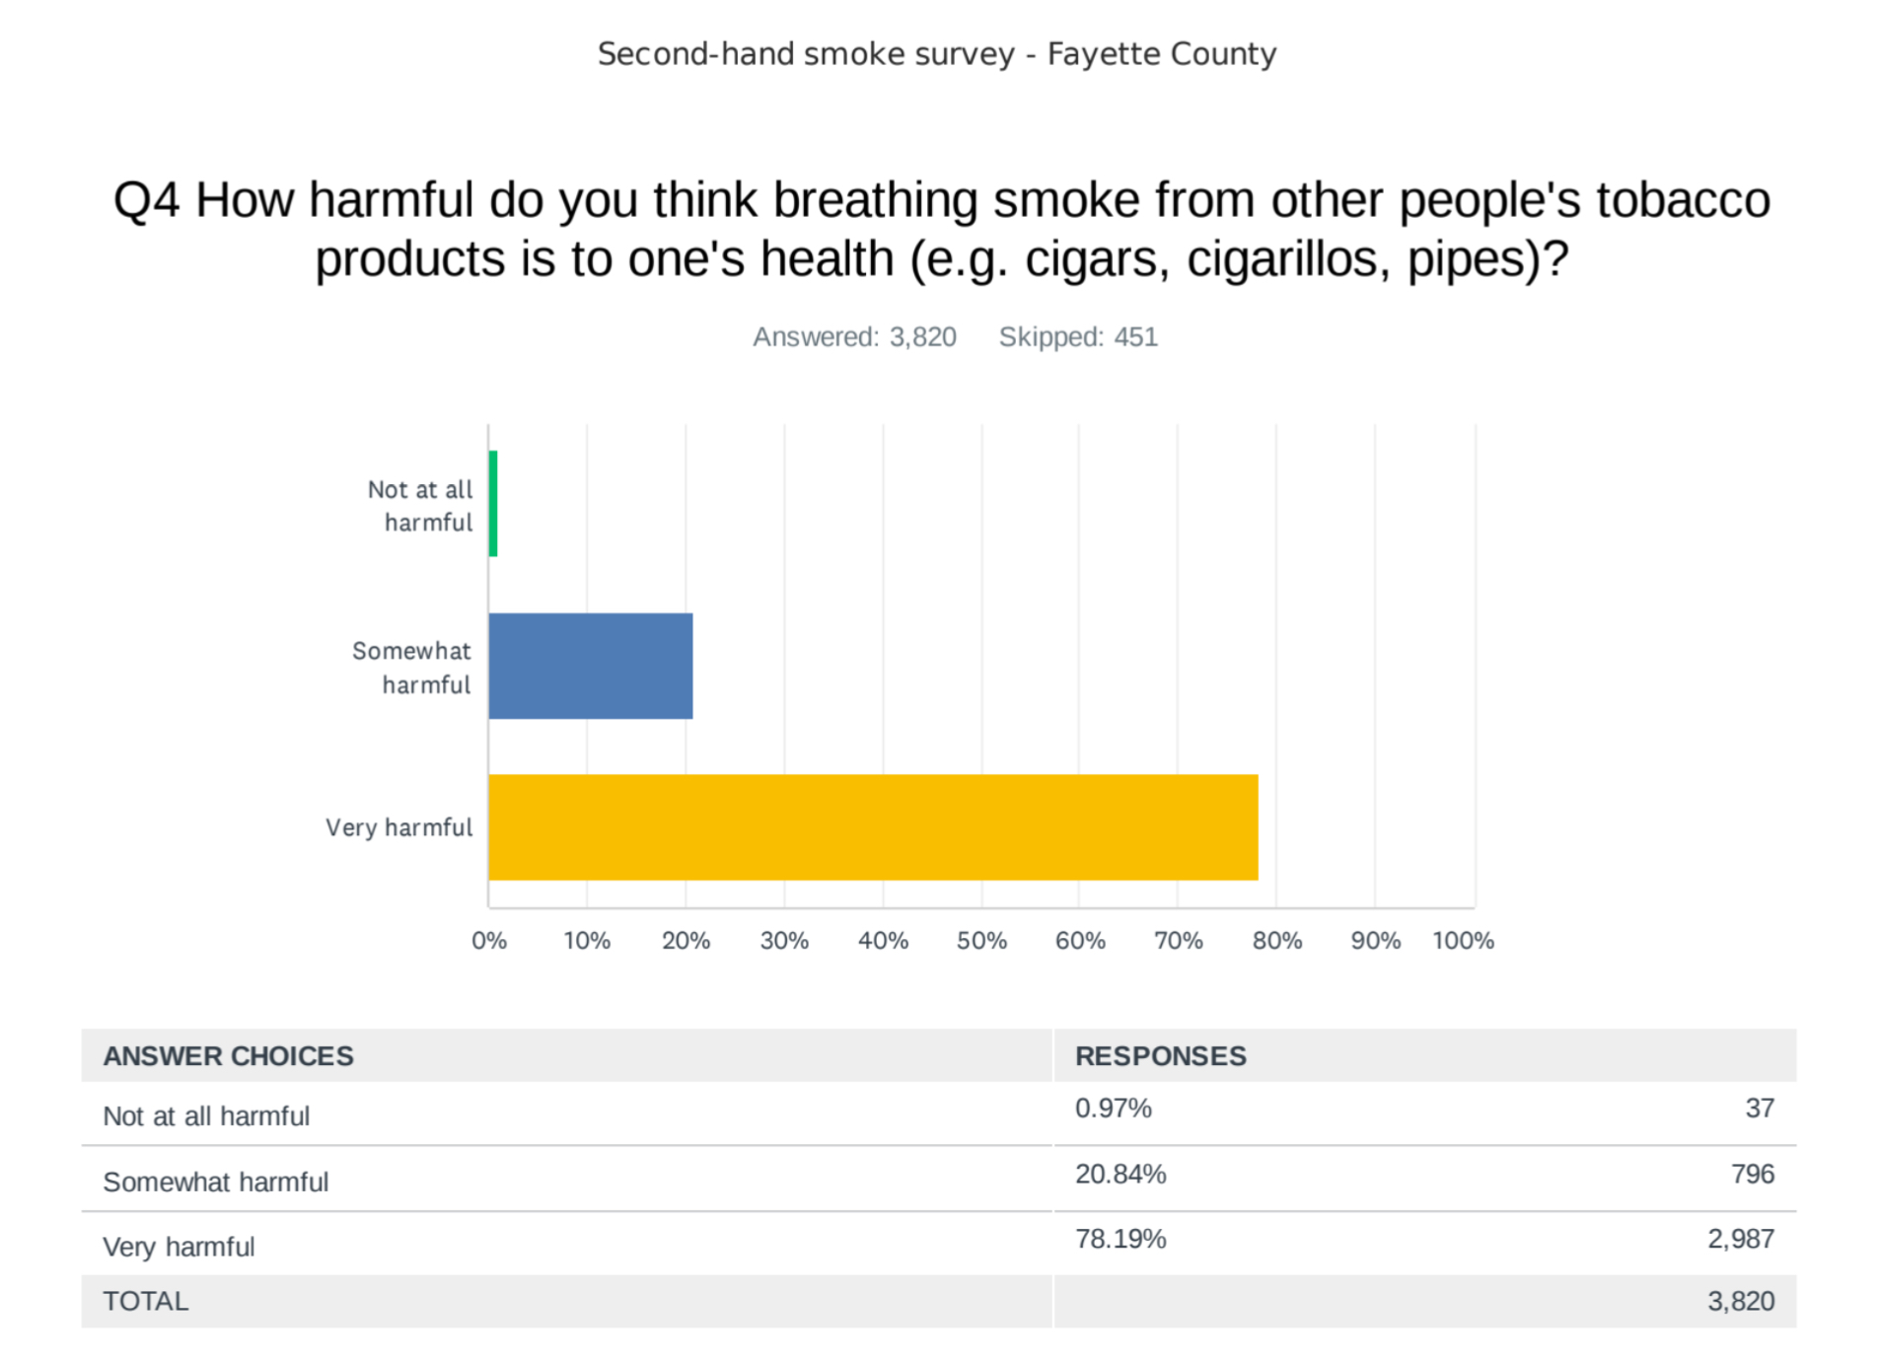
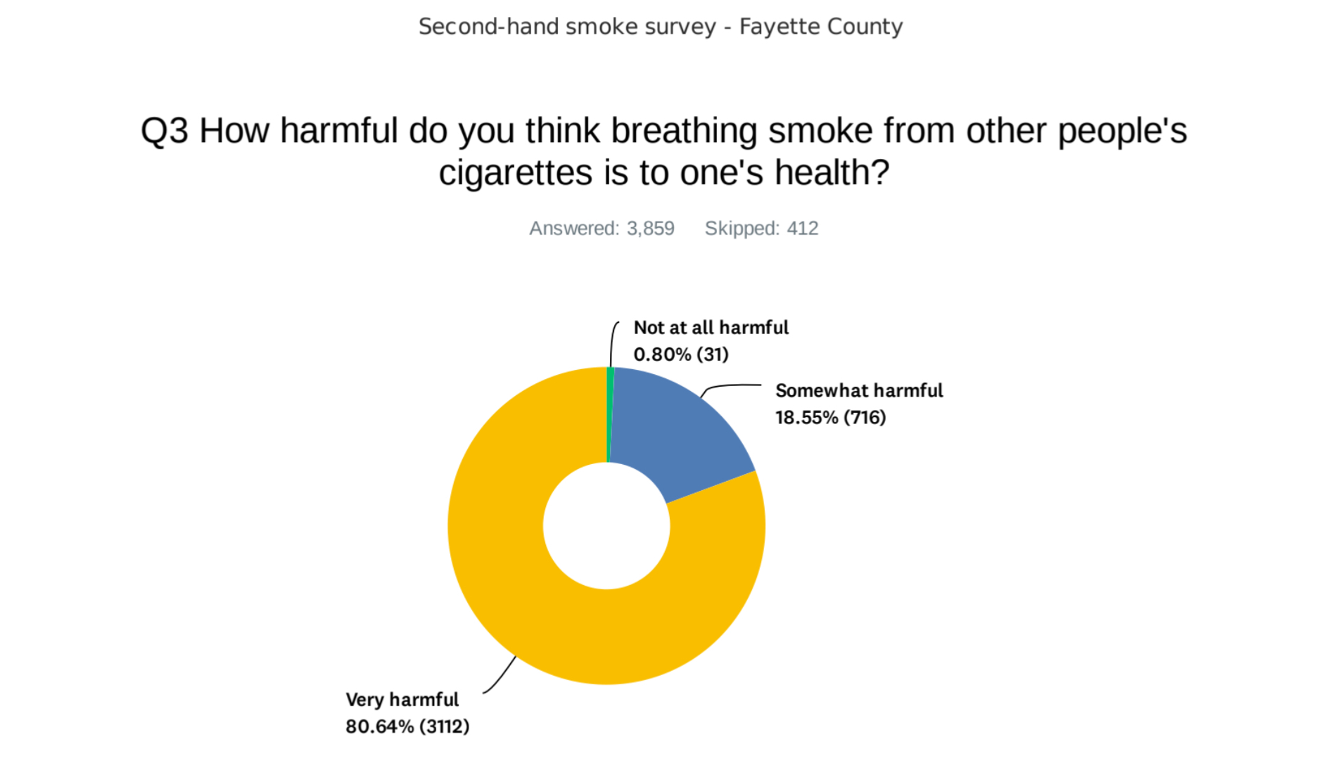
How Does Your Community Feel About Smokefree Environments?
Notes:
Polls can be expensive, but small-scale surveys can be just as effective

Slide 11
Educate on the Issue
Your community needs to understand WHY a change is needed
Engage in outreach and education activities to lay the foundation for change

Slide 12
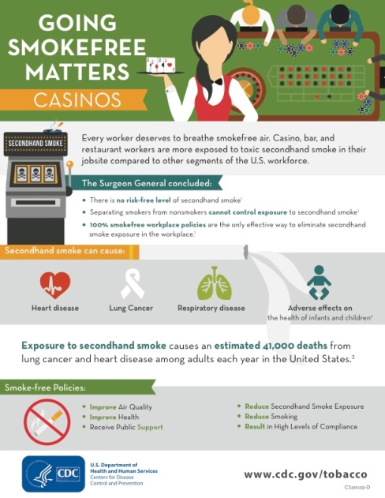
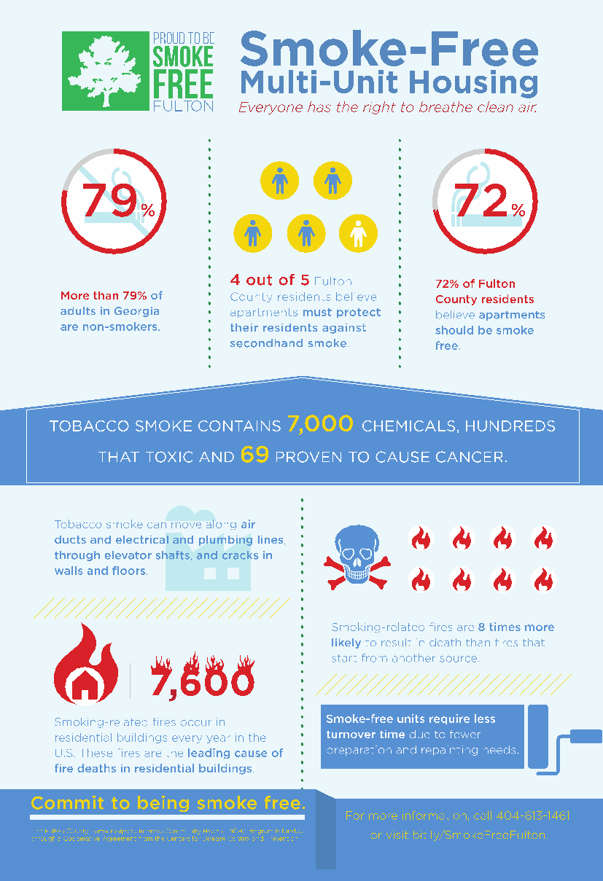
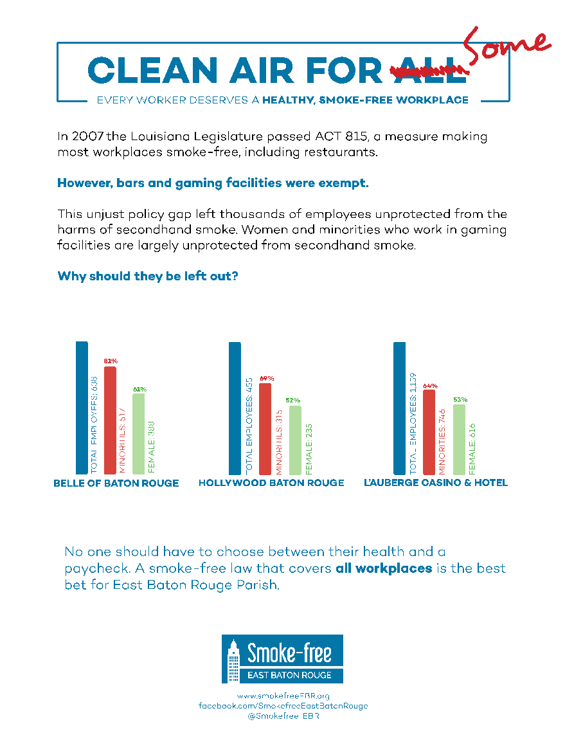
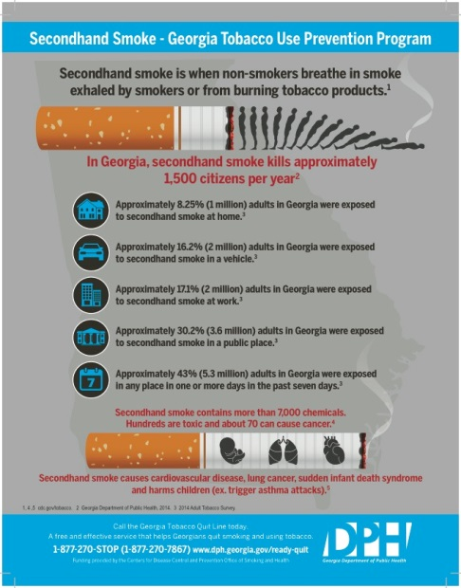
Leveraging Your Expertise: Messaging the Issue
EDUCATE YOUR COMMUNITY

Slide 13
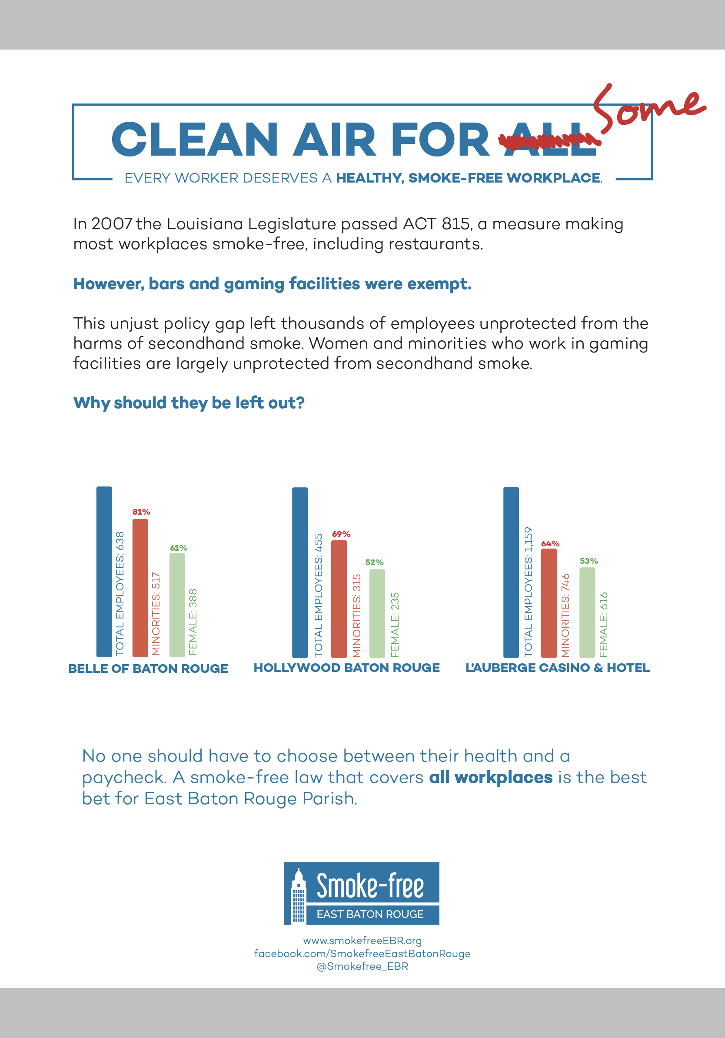
Messaging… Make it Relevant
EDUCATE YOUR COMMUNITY
Don’t be afraid to translate the message
Potential partners want to know “why should we care?”

Slide 14
Be prepared to take on tough issues
EDUCATE YOUR COMMUNITY

Slide 15
Messaging: Smokefree is Good for Business
EDUCATE YOUR COMMUNITY

Slide 16
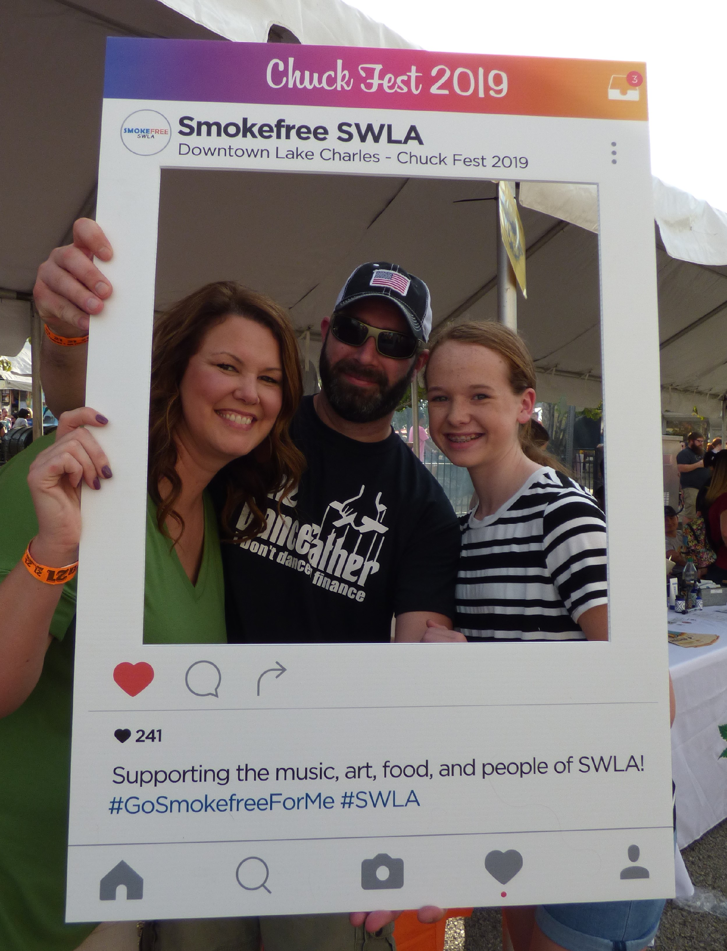
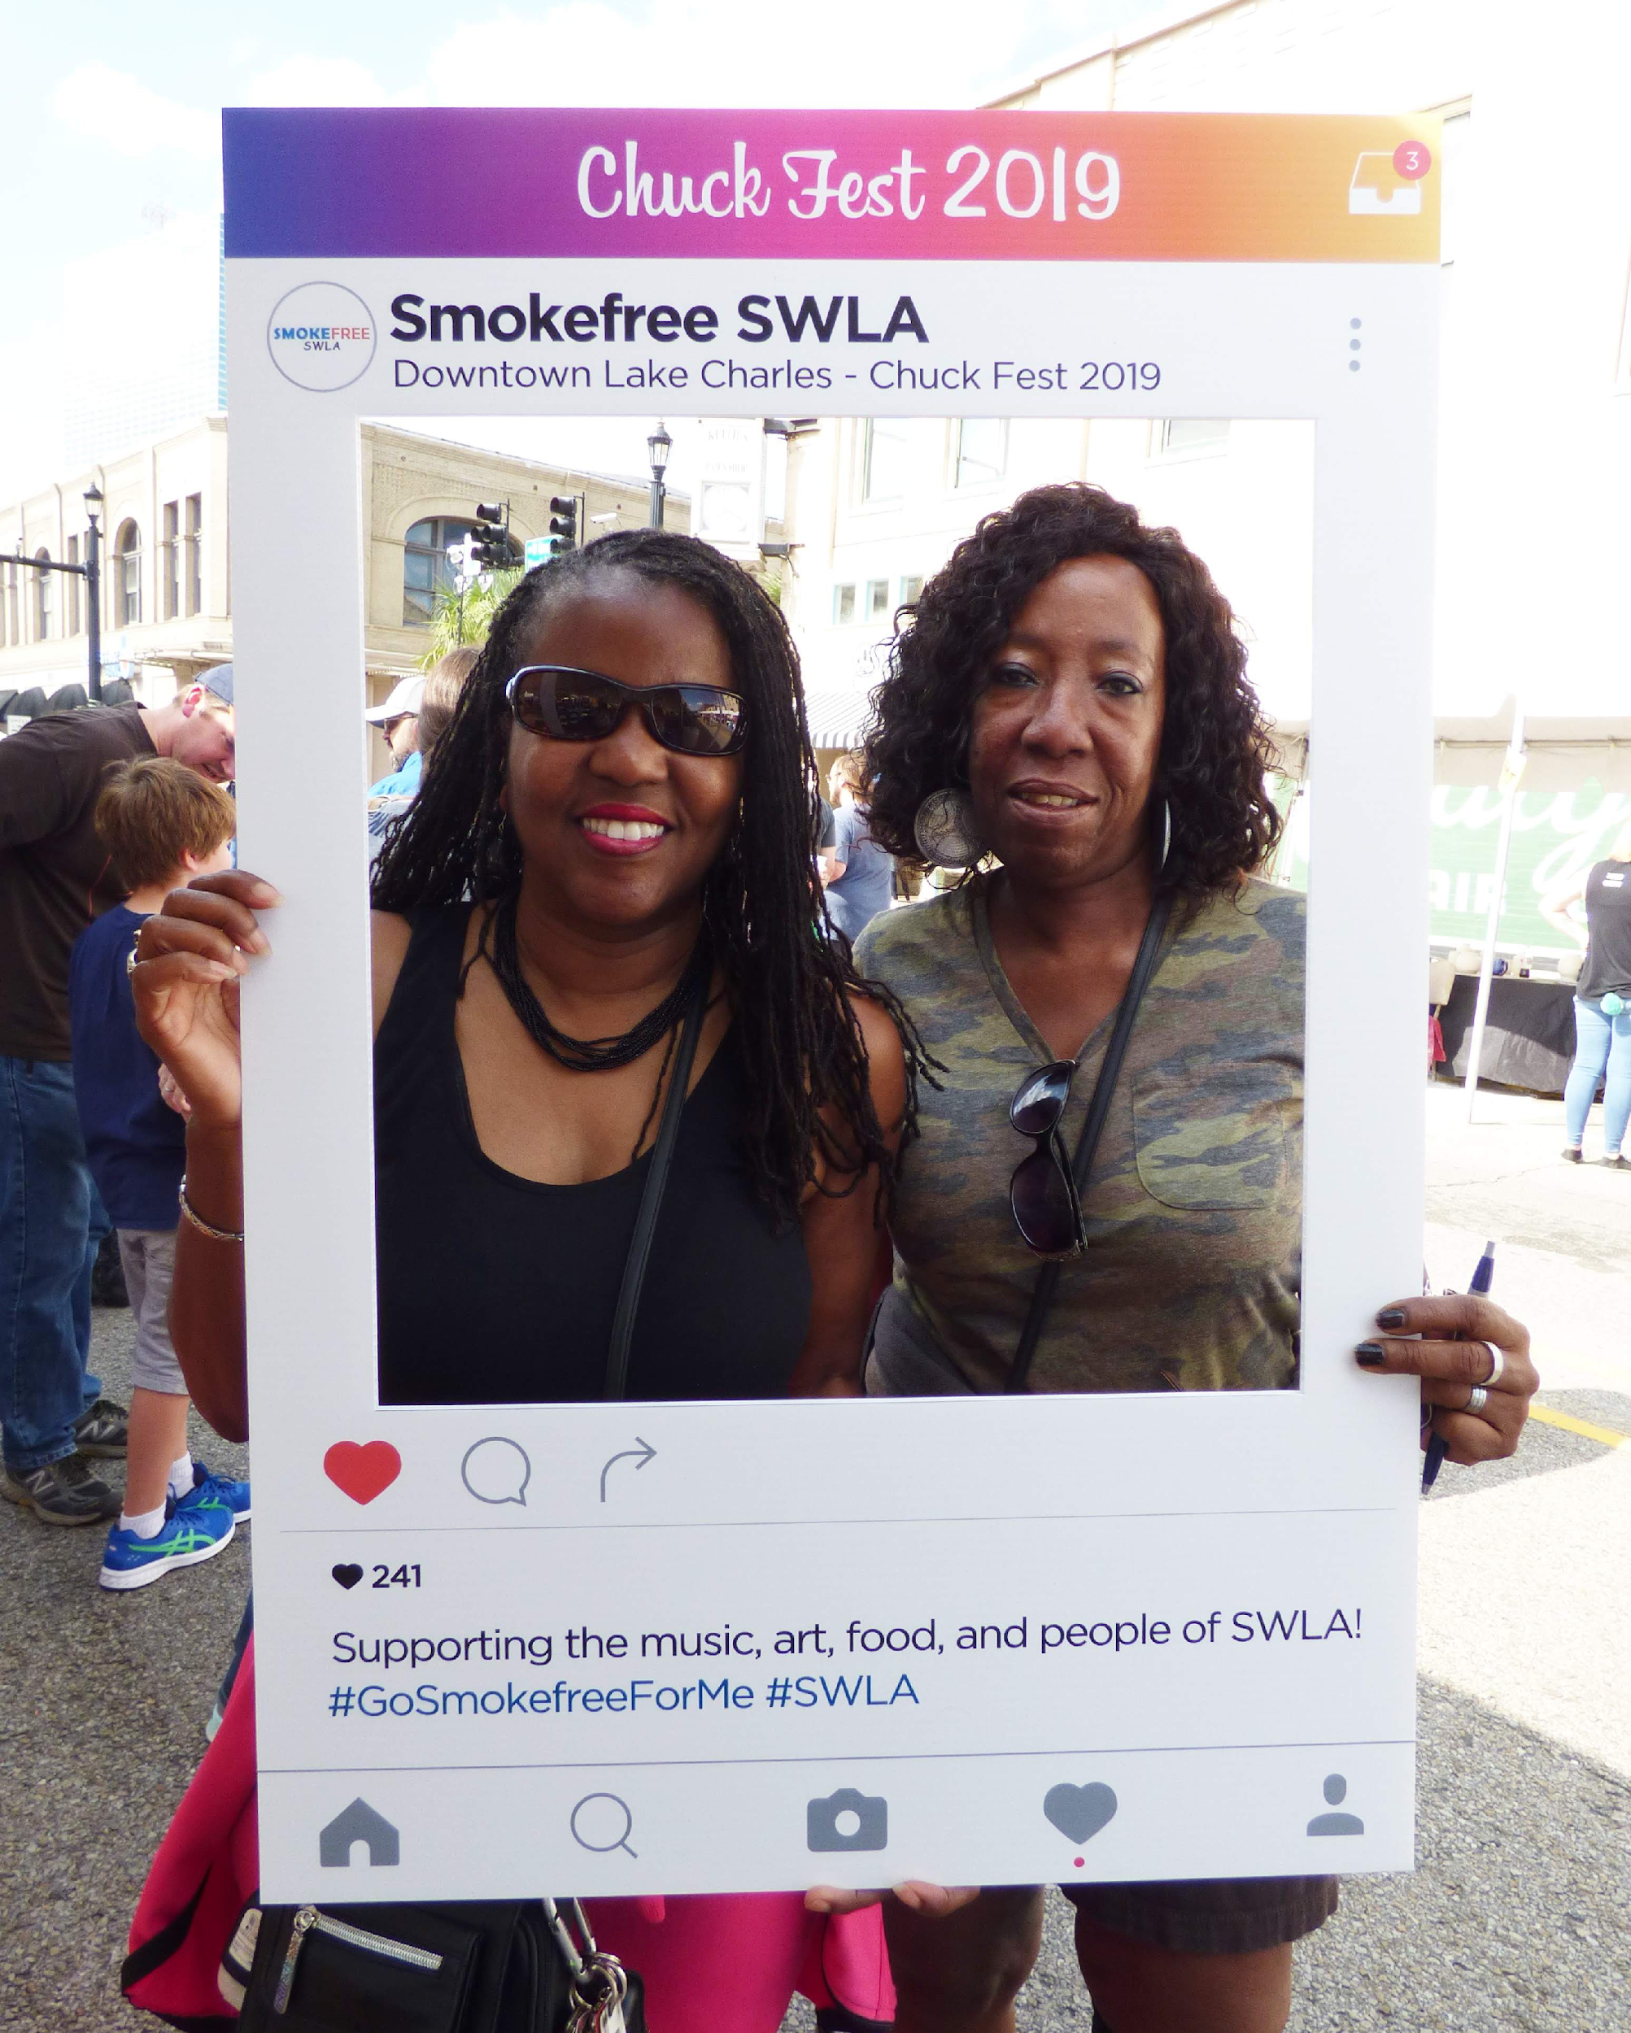
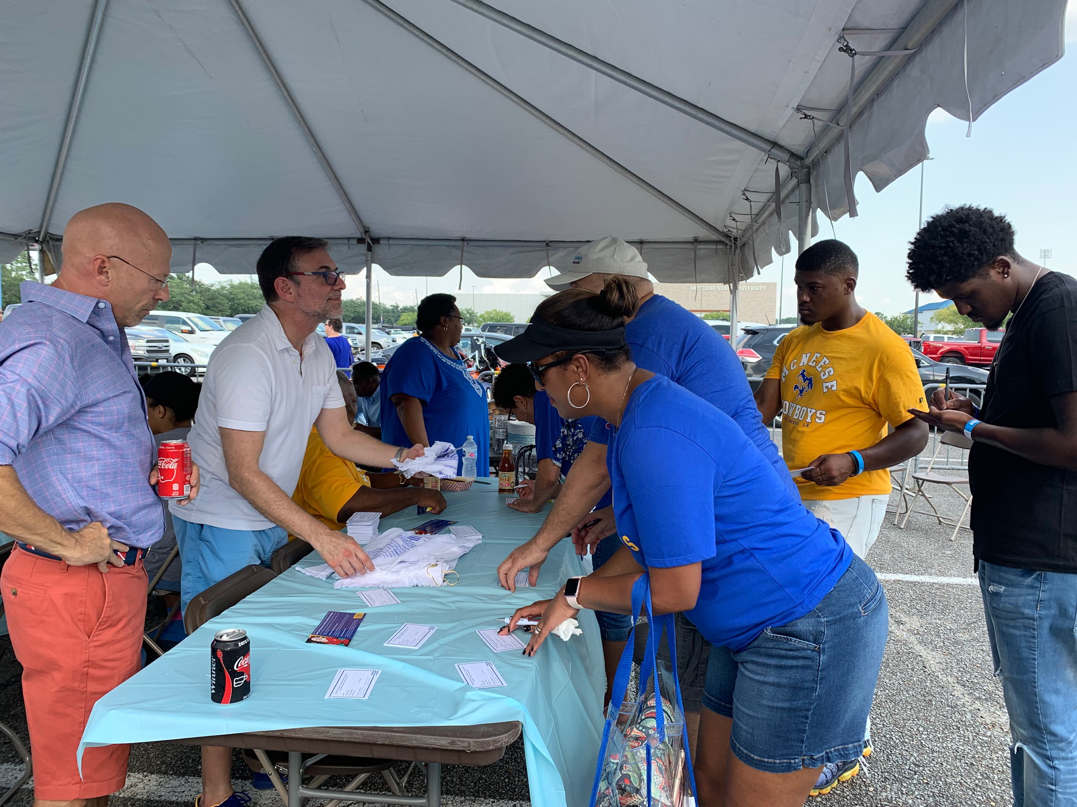
Community Engagement Activities: Be EVERYWHERE you can be!
EDUCATE AND BUILD POWER
Football Tailgate Events
Community Festivals
High-Visibility Sporting Events
Health Fairs
Business Meetings
Social Meetings
Health Events
Music Festivals
Flea Markets
Cookouts
Bar events

Slide 17
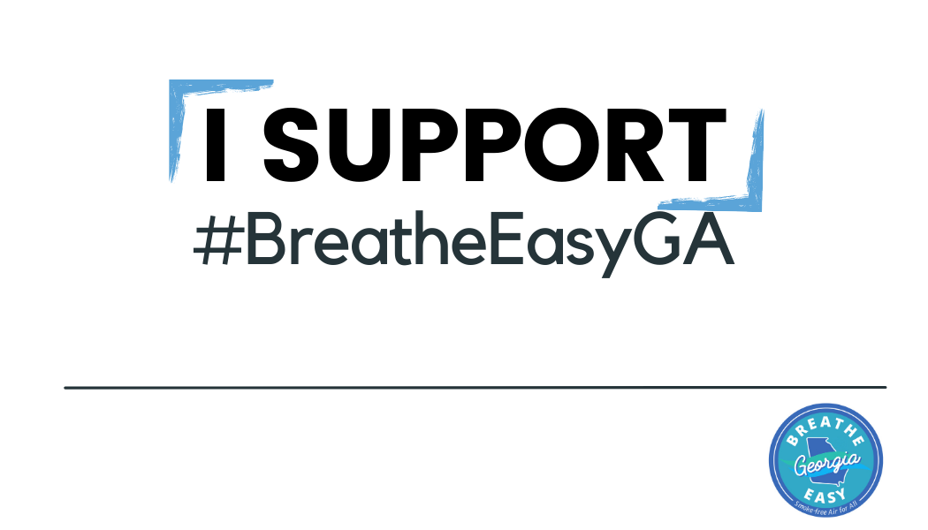
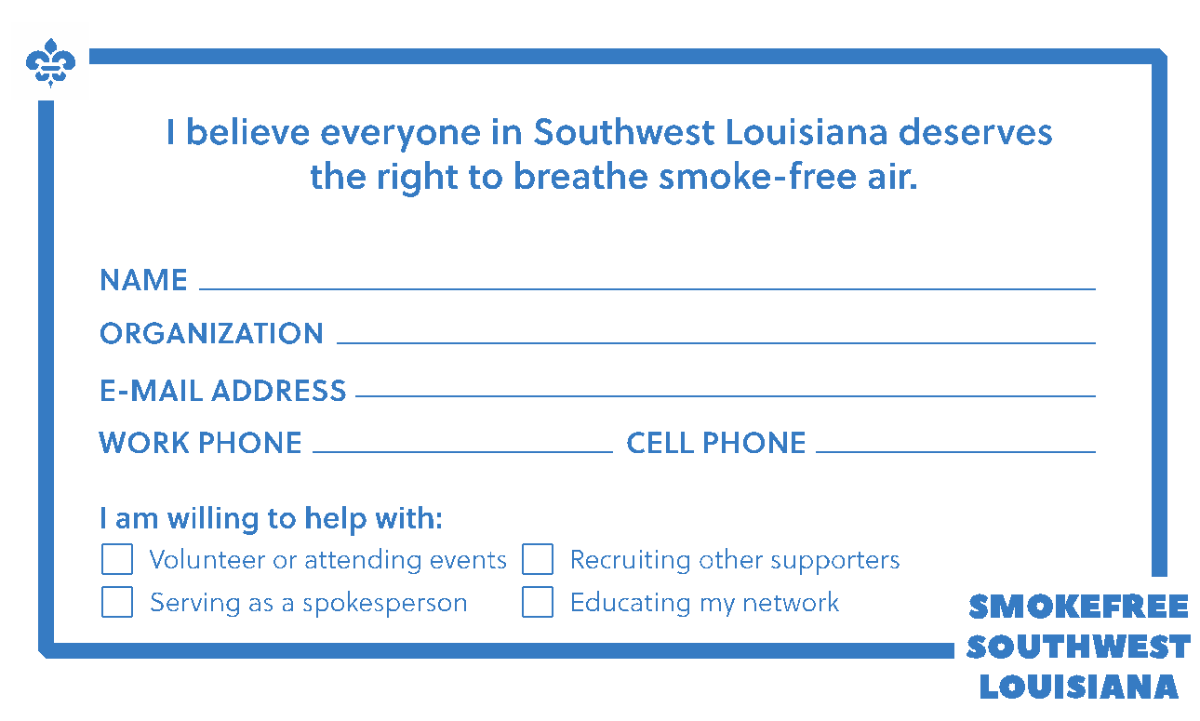
Collect Info For Future Advocacy Efforts
EDUCATE AND BUILD POWER

Slide 18
Speak Up to Support Change
ADVOCATE FOR POLICY CHANGE
Ready for Change…
Now that your community believes there is a problem…
they are ready to do something about it!
Notes:
Your outreach efforts will help you find advocates…

Slide 19
Keys to a Successful Advocacy Campaign
ADVOCATE FOR POLICY CHANGE
Tell the Story
YOU tell the story until you can get workers to tell their own.
Partnerships
Build partnerships with organizations that reach your targets.
Stay on Message
YOUR messages
Expect the Unexpected
Prepare your coalition and council supporters on opposition arguments and tactics.
Be prepared to respond quickly.

Slide 20
Message Development
ADVOCATE FOR POLICY CHANGE
What do they need to hear? (Messages)
Who do they need to hear it from? (Messengers)
How can we get them to hear it? (Delivery)

Slide 21
Messaging Worksheet
ADVOCATE FOR POLICY CHANGE
WHO needs to hear your message? | WHAT INFORMATION do they need to hear? (MESSAGE) |  | WHO do they need to hear it FROM? (MESSENGER) | HOW to get the message to them? (DELIVERY) | Notes | Due Date
 | PUBLIC HEALTH MESSAGES | ECONOMIC IMPACT MESSAGES
Notes:
MESSAGING WORKSHEET
Use the spreadsheet below to identify targets (potential partners, stakeholders, decision makers, etc) and strategies for reaching each group. Keep in mind that different targets may require different messages/messengers. See next page for a SAMPLE completed worksheet.

Slide 22
ADVOCATE FOR POLICY CHANGE
WHO needs to hear your message? | WHAT INFORMATION do they need to hear? (MESSAGE) | WHO do they need to hear it FROM? (MESSENGERS) | HOW to get message to them? (DELIVERY)
 | PUBLIC HEALTH MESSAGES | ECONOMIC IMPACT MESSAGES
Mayor |  | Smokefree is good for business | Business leaders Chamber Tourism | Letter from coalition Phone call intro
City Council (Add a row for each council member) |  | Voters Support the Issue | Voters
Councilman Billy Bob Dist 1 | supporting healthy, smokefree environments for Dist 1 citizens | Smokefree environments are welcoming for all patrons | - Voters - Local bar owner | Emails Facebook comments
Councilwoman Mary Joe Dist 2 | Dist 2 residents deserve healthy, smokefree environments |  | Survivor | Coffee mtg
Chamber of Commerce | Smokefree = Healthy, vibrant communities | Smokefree is good for business | Other smokefree cities economists
Civic Organizations (Add row for each organization) | Everyone has a right to a smokefree workplace |  | Coalition Community leaders
Casinos | SHS makes breathing difficult | Casino patrons want a smokefree environment | Casino patrons | Facebook comment section
General community (personal stories) | No safe level of exposure Smokefree = work/live/play |  | Coalition Health dept CDC Other health groups? | Social media Listserv Community events

Slide 23
Build a Network of Voices
ADVOCATE FOR POLICY CHANGE
Concerned Citizens
Community Based Orgs
Faith Community
Lived Experiences
Bar Owners
Coalition
Health Community
Workers
Former Smokers
Business Community
Notes:
Ideally, you want to build a network of powerful and passionate voices that represent your community and can influence decision makers.

Slide 24
Tell your story: Smokefree Workplaces Matter
ADVOCATE FOR POLICY CHANGE
MESSAGES, MESSENGERS, & STORYTELLING
Leverage youth voices to advocate for their parents.

Slide 25
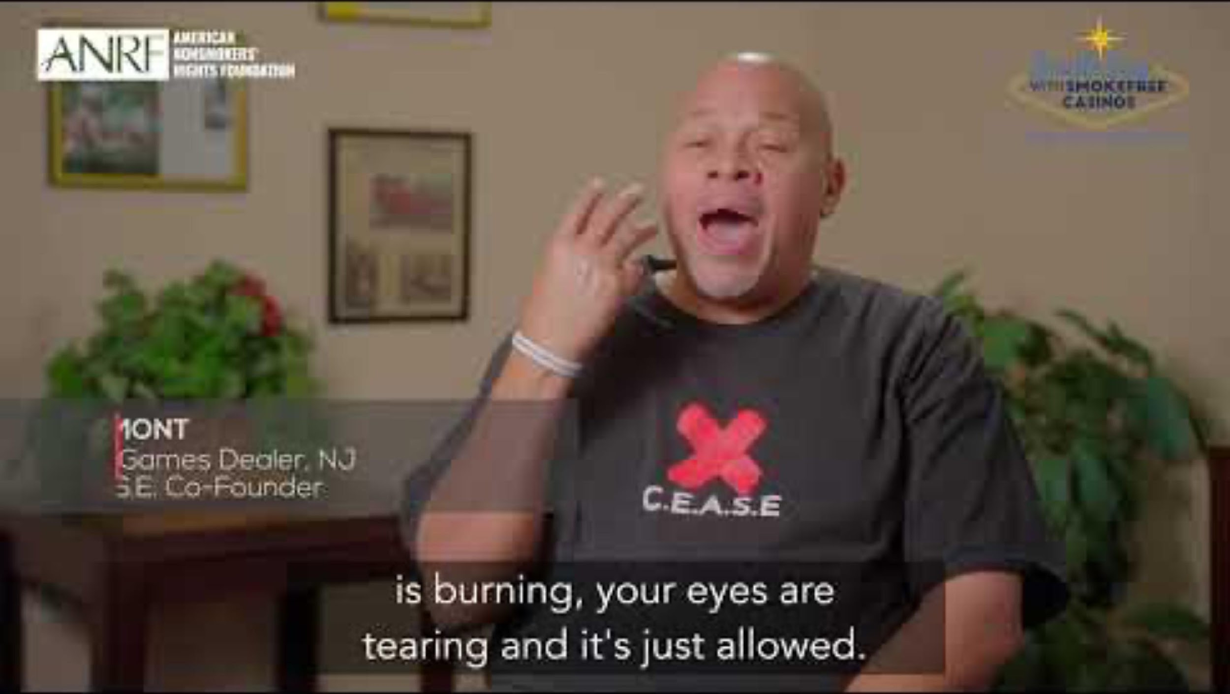
STORYTELLING
ADVOCATE FOR POLICY CHANGE
MESSAGES, MESSENGERS, & STORYTELLING
Move from numbers and creative to real people and their stories and
Personal stories from workers experiencing secondhand smoke exposure in their workplaces.

Slide 26
ADVOCATE FOR POLICY CHANGE
MESSAGES, MESSENGERS, & STORYTELLING
Notes:
Deacon John pic and Let’s Be Totally Clear Campaign goes back to 2009-2010

Slide 27
ADVOCATE FOR POLICY CHANGE
MESSAGES, MESSENGERS, & STORYTELLING
EMPLOYEES

Slide 28
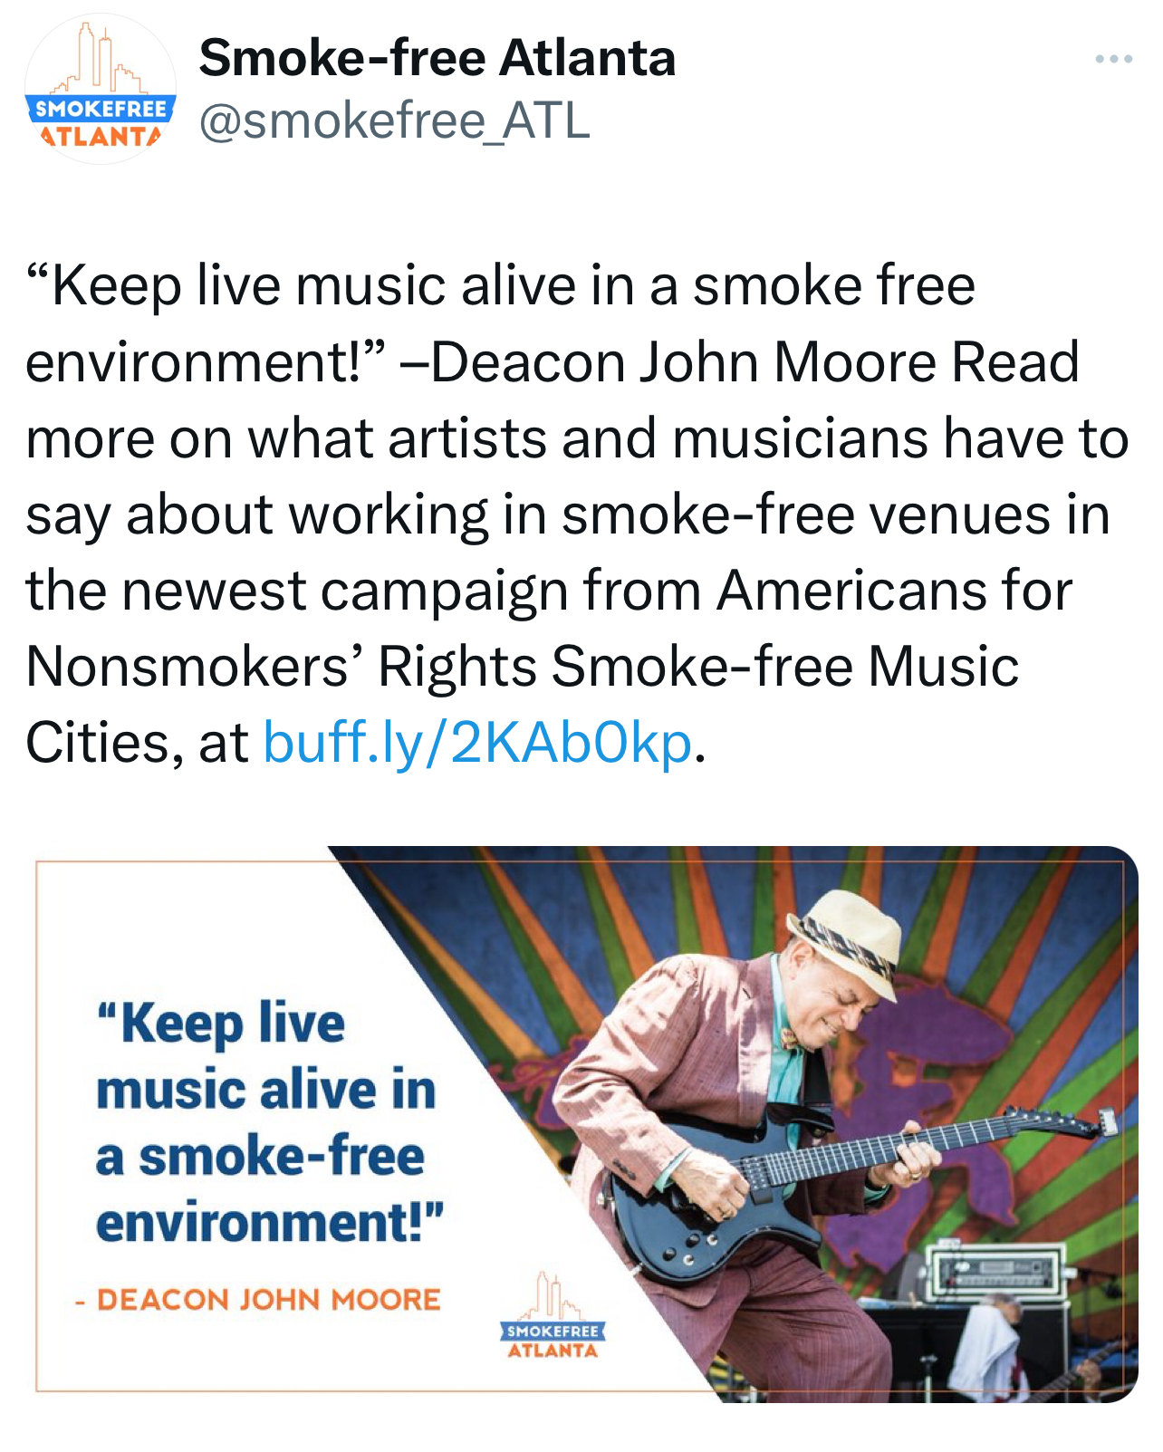
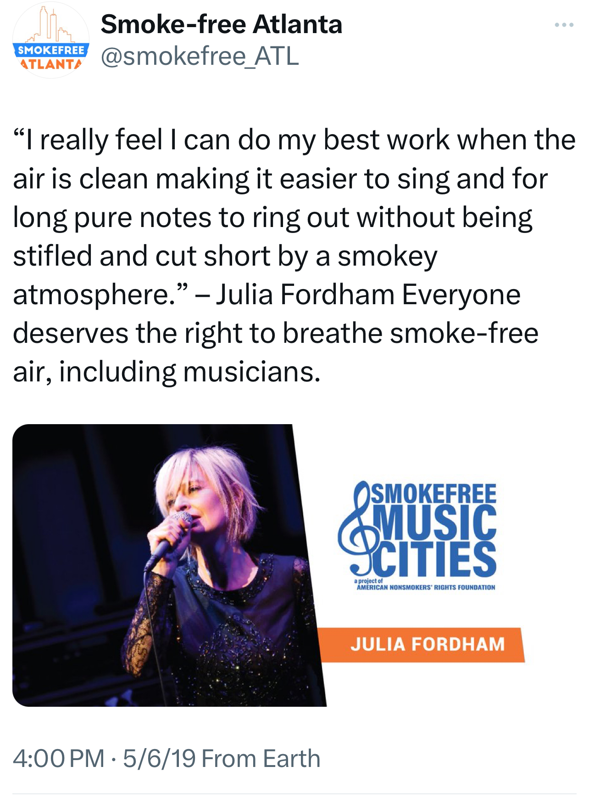
MUSICIANS
ADVOCATE FOR POLICY CHANGE
MESSAGES, MESSENGERS, & STORYTELLING

Slide 29
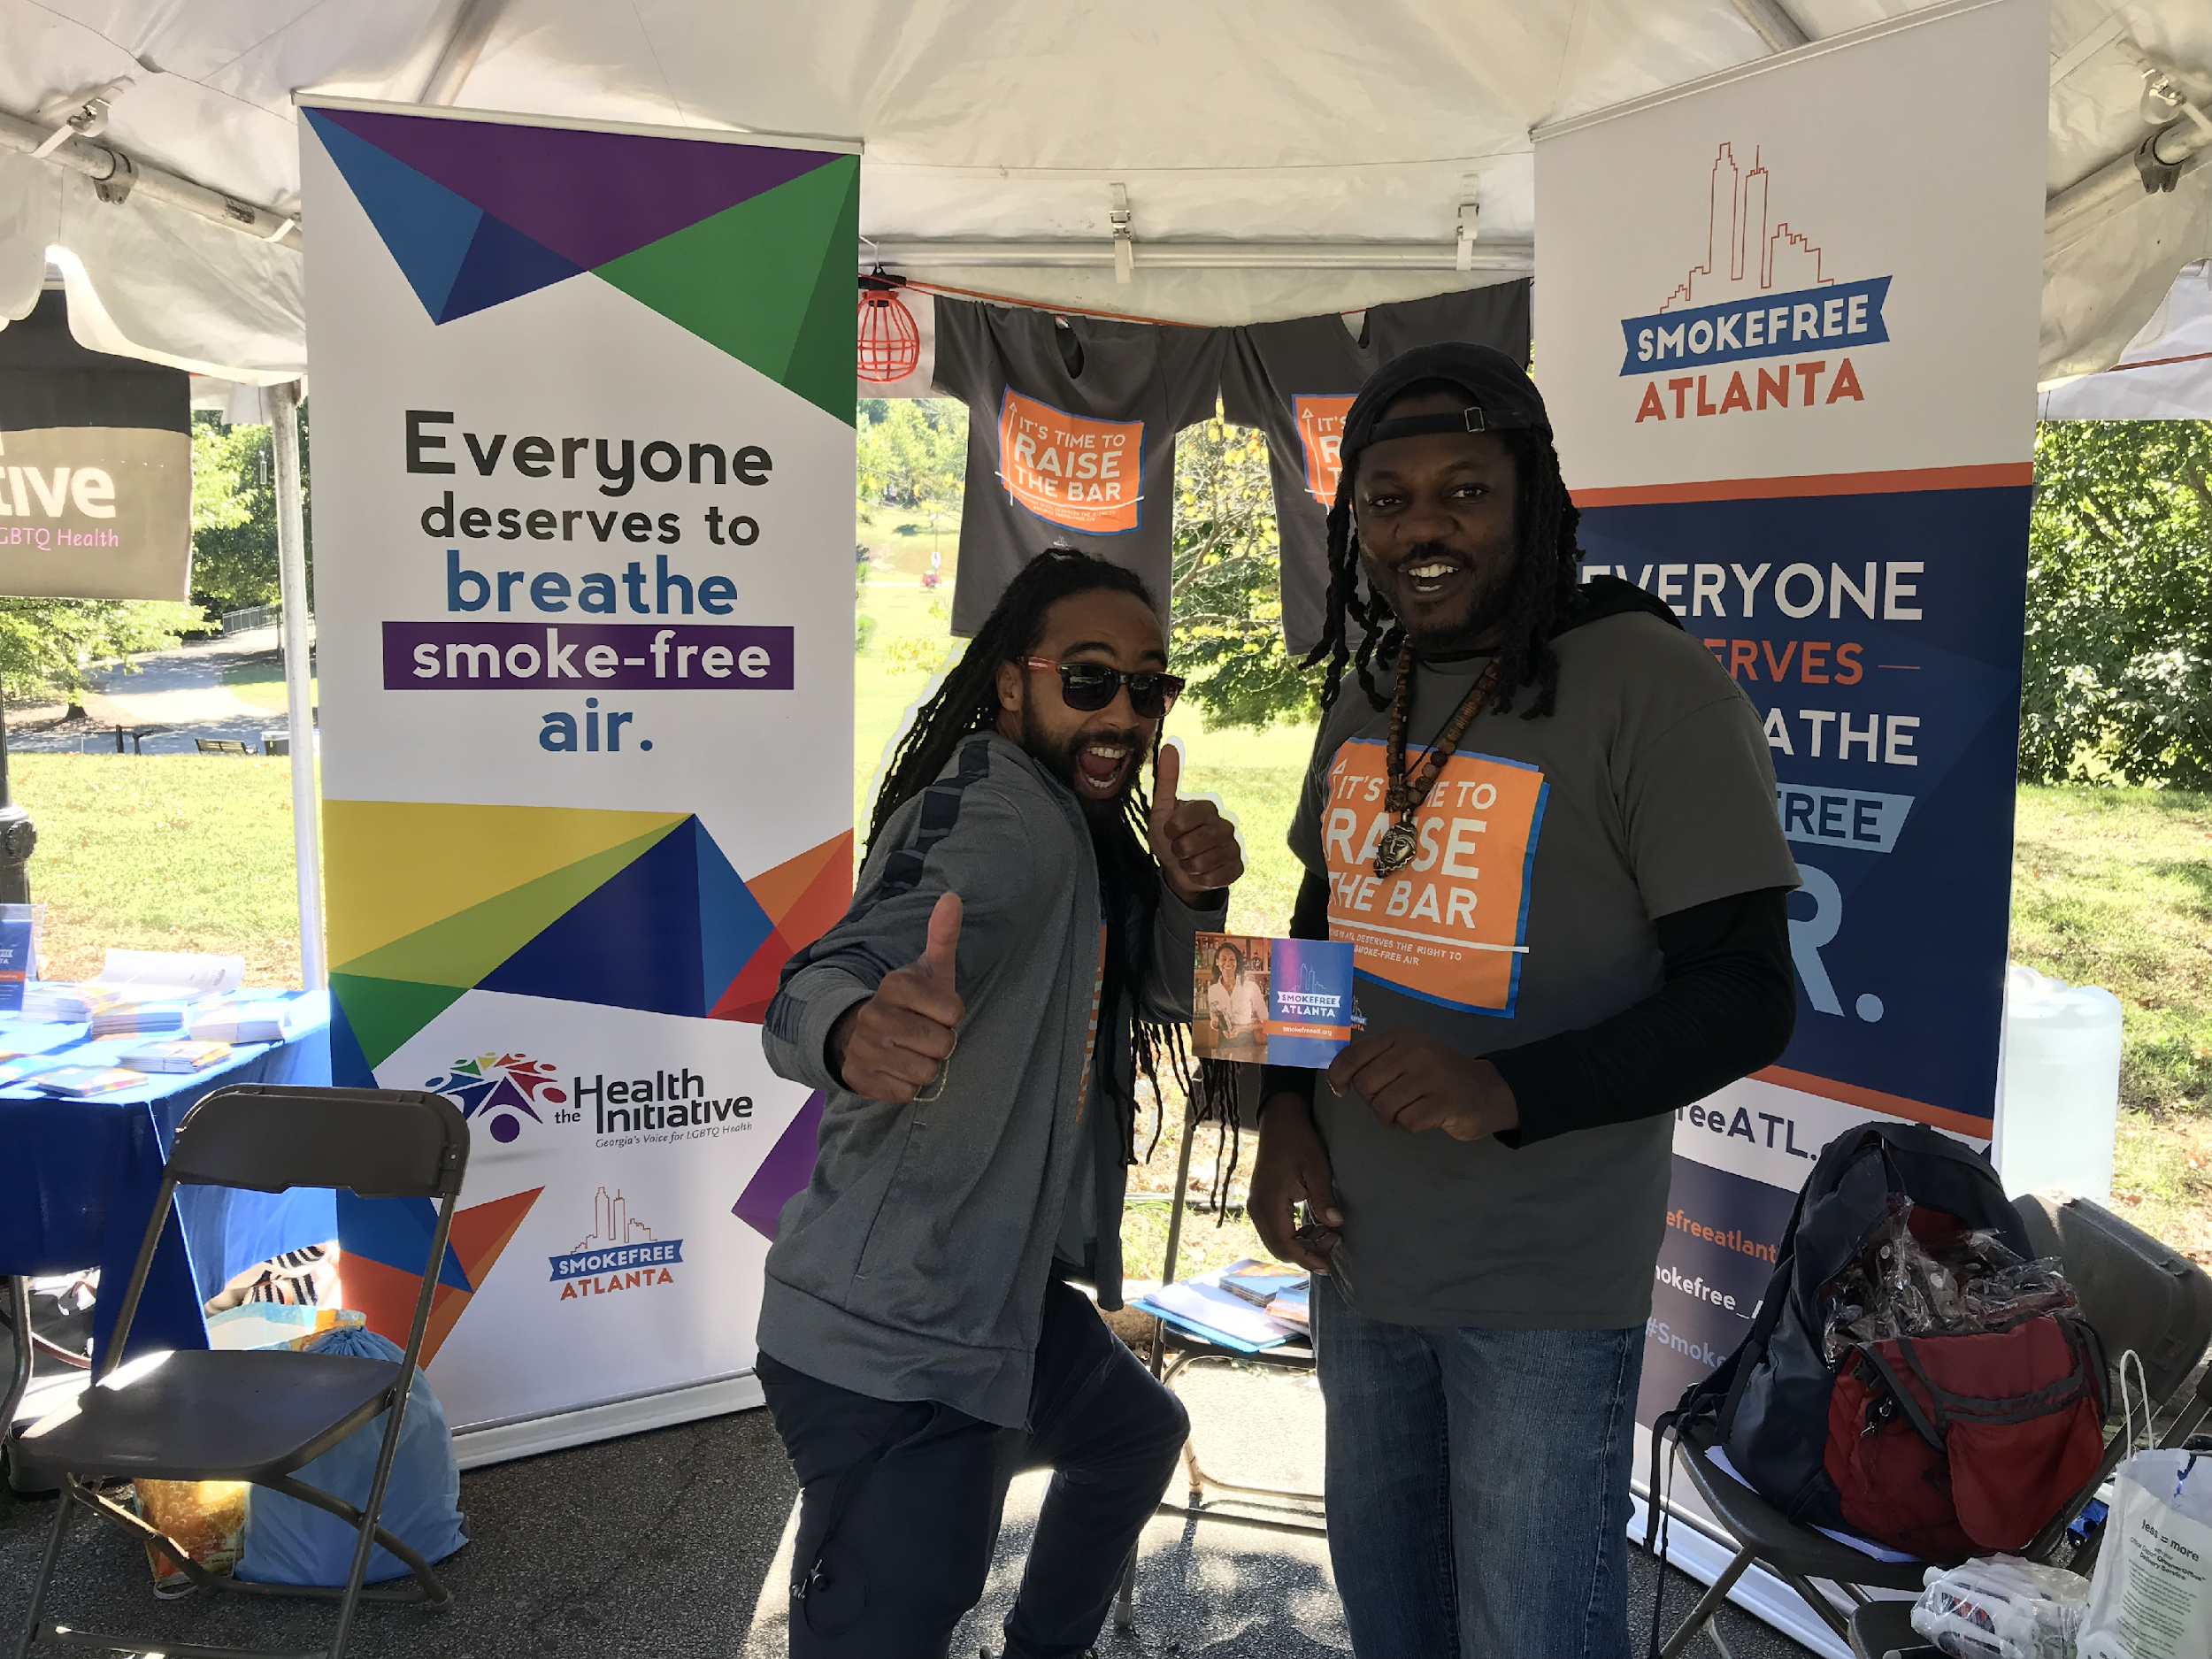
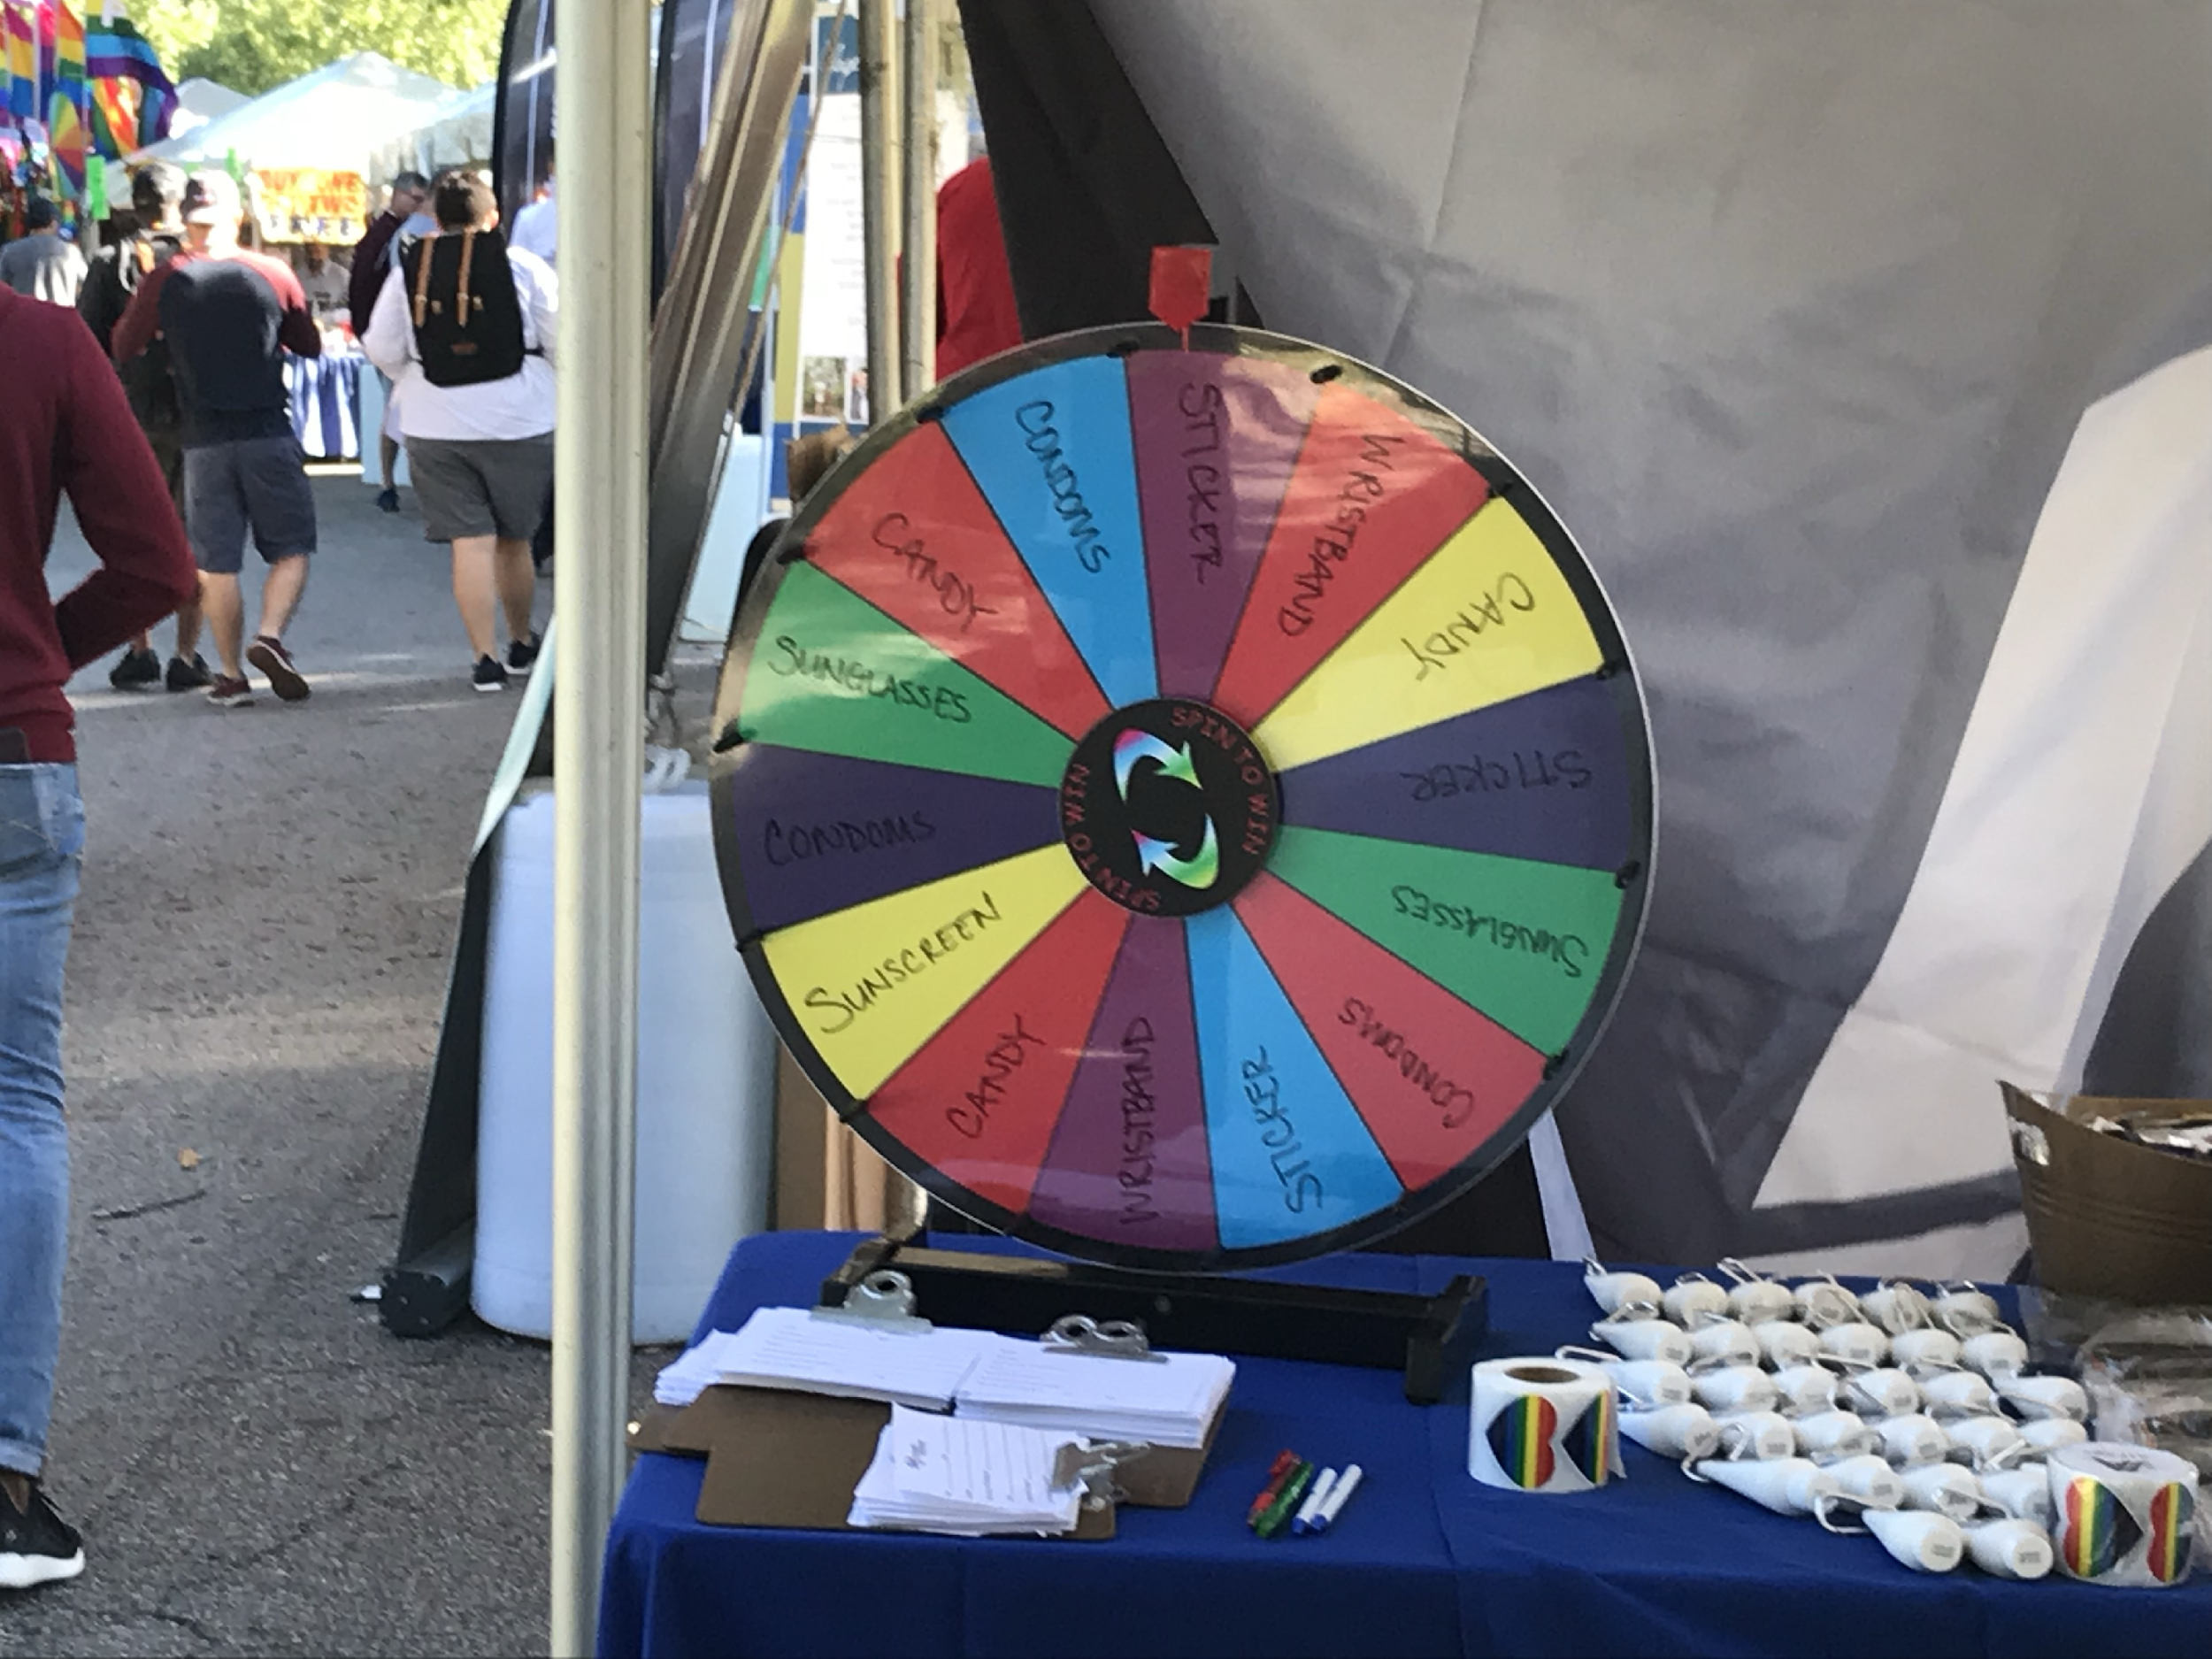
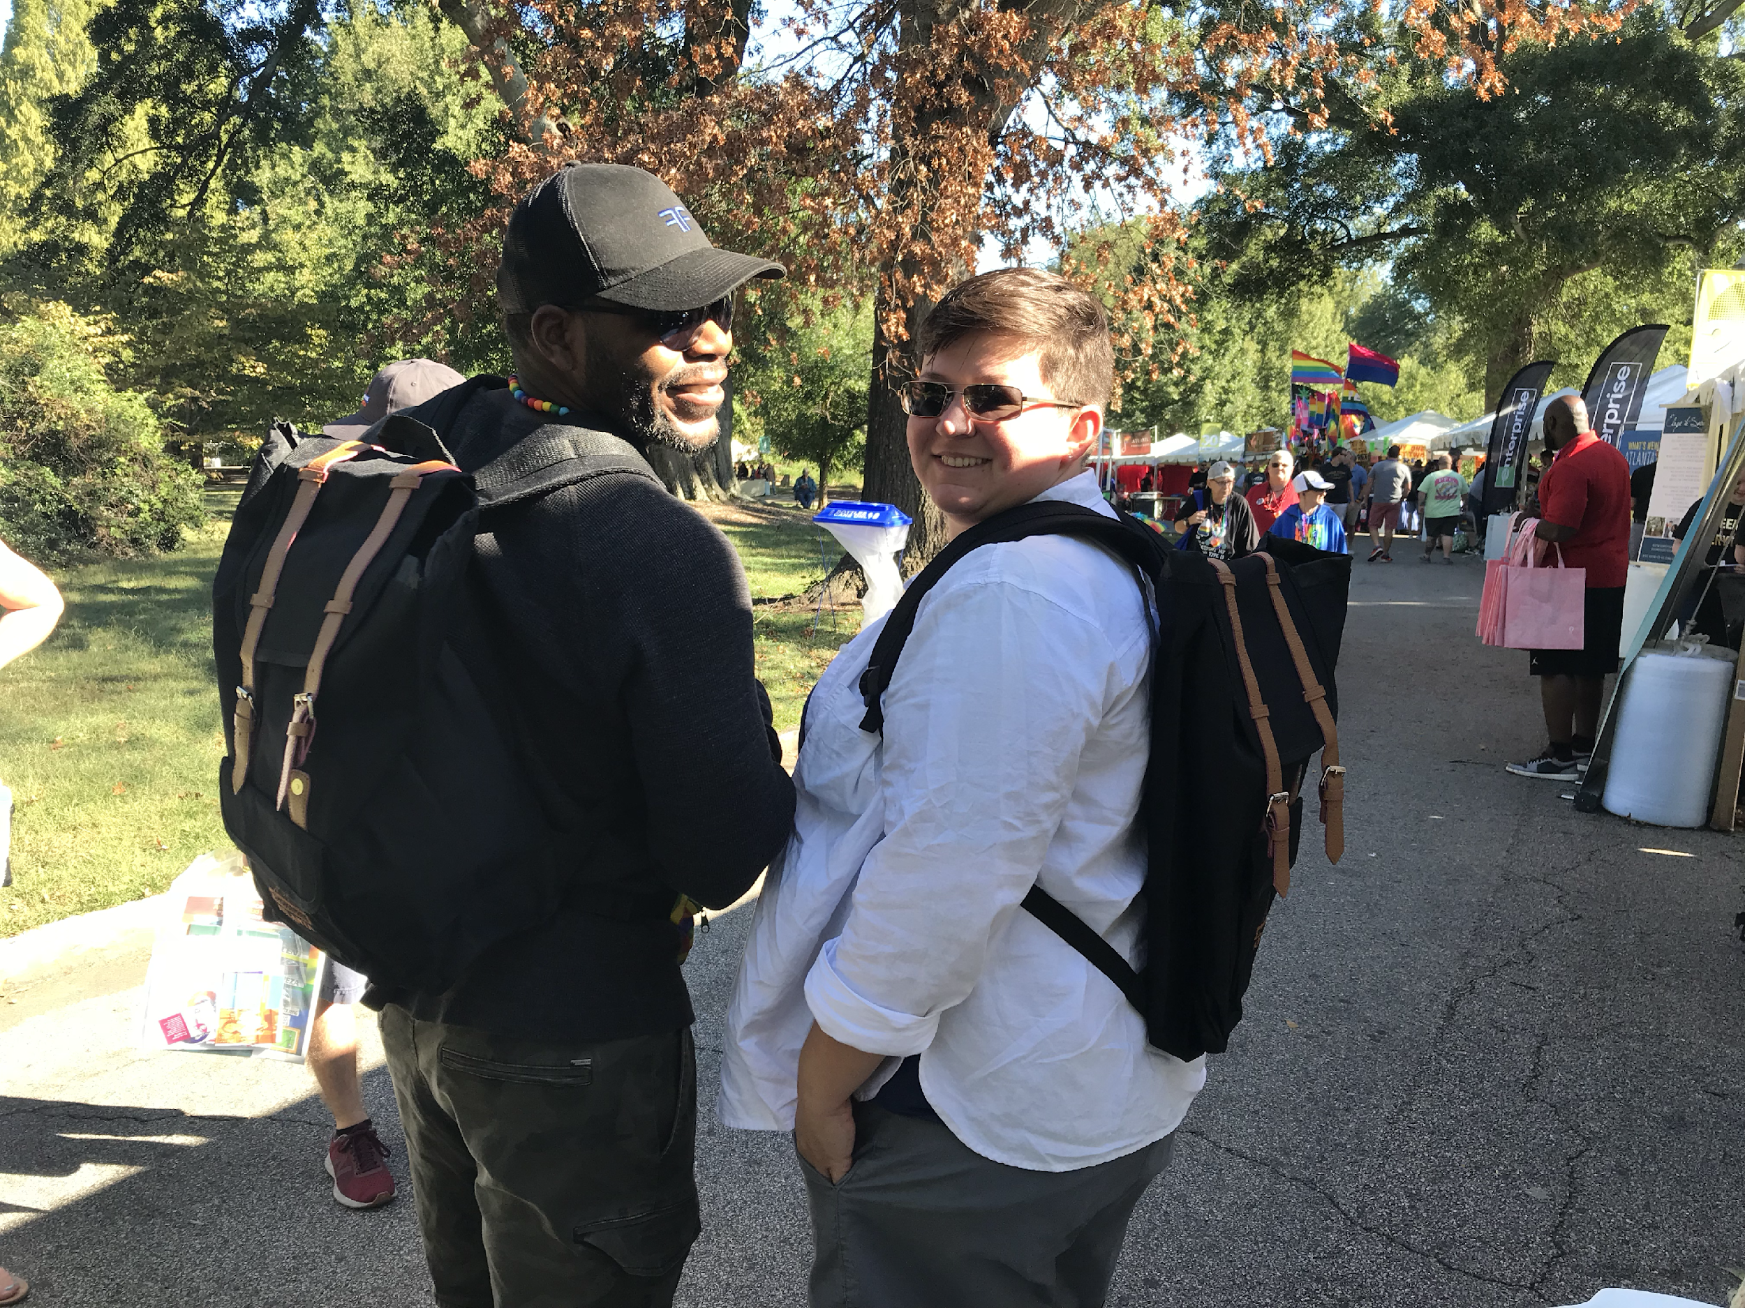
LGBT Health Initiative
ADVOCATE FOR POLICY CHANGE
COMMUNITY PARTNERS
MESSAGES, MESSENGERS, & STORYTELLING
Smokefree Pride
Smokefree Gay Bars Campaign
Co-branded materials
(sunglasses, sunscreen, condoms)

Slide 30
ADVOCATE FOR POLICY CHANGE

Slide 31
GETTING THE WORD OUT
ADVOCATE FOR POLICY CHANGE
Paid Media
Billboards
TV & Radio
Print Ads
Social Media Boosting
EARNED MEDIA
Editorials
LTEs
Opinion pieces
Media events
NON-TRADITIONAL MEDIA
Social media
Digital ads
Influencers
E-advocacy

Slide 32
Outreach to Local Officials
ADVOCATE FOR POLICY CHANGE
Who has the power?
How can we reach them?

Slide 33
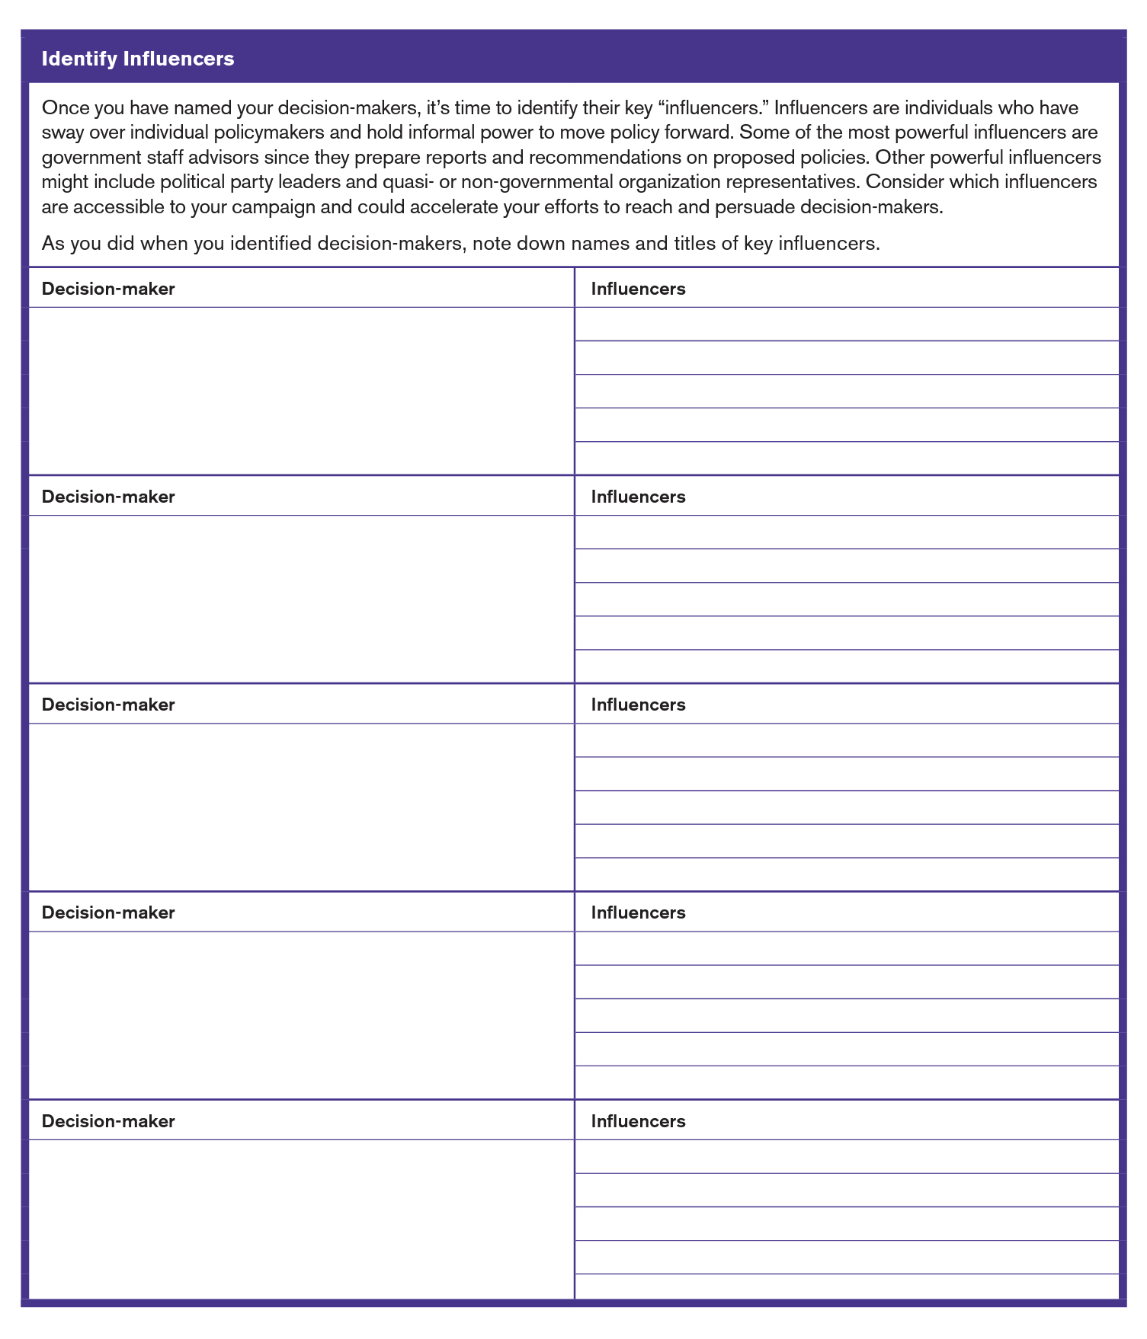
ADVOCATE FOR POLICY CHANGE
Political Assessment:
Do Your Homework
Taken from the
ADVOCACY ACTION GUIDE: A TOOLKIT FOR STRATEGIC POLICY ADVOCACY CAMPAIGNS
https://www.tobaccofreekids.org/assets/global/pdfs/en/BAI_Advocacy_Toolkit.pdf

Slide 34
Political Assessment
ADVOCATE FOR POLICY CHANGE
Advocacy Action Guide: A ToolKit for Strategic Policy Advocacy Campaigns
https://www.tobaccofreekids.org/assets/global/pdfs/en/BAI_Advocacy_Toolkit.pdf

Slide 35
Anticipate Opposition
ADVOCATE FOR POLICY CHANGE
What groups are (or will be) in strongest opposition?
What steps can we take to reduce the legitimate effects of the opposition?

Slide 36
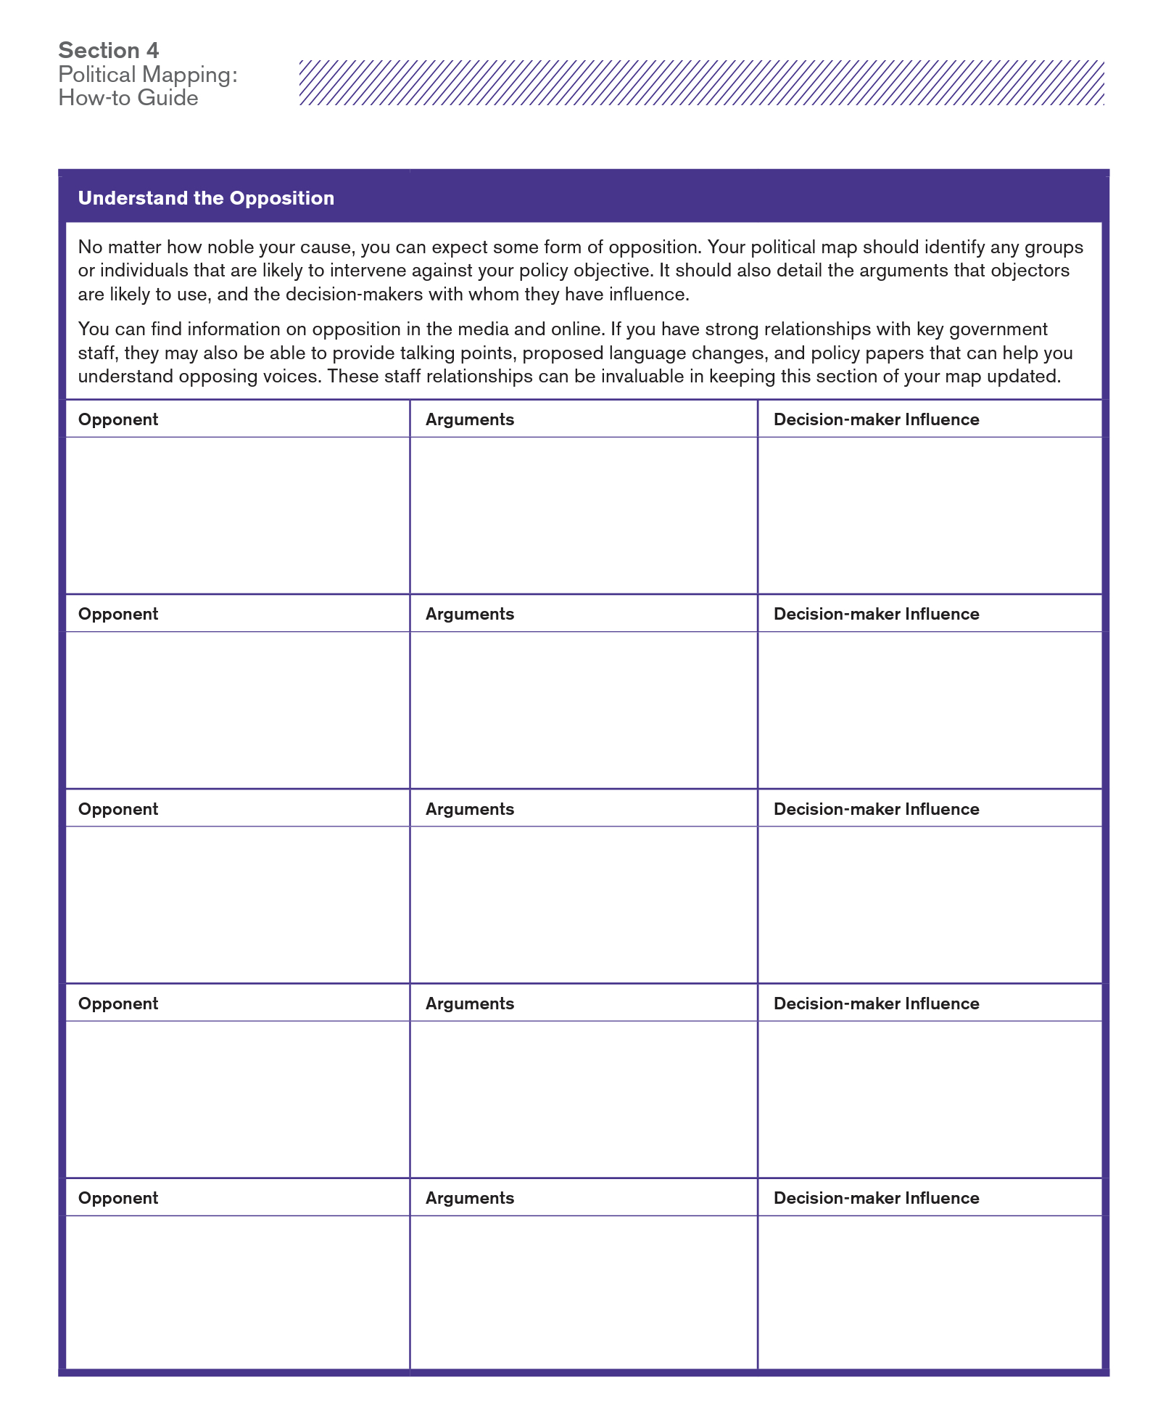
Understand Your Opposition
ADVOCATE FOR POLICY CHANGE
Taken from the
Advocacy Action Guide: A ToolKit for Strategic Policy Advocacy Campaigns
https://www.tobaccofreekids.org/assets/global/pdfs/en/BAI_Advocacy_Toolkit.pdf

Slide 37
Anticipate Opposition Arguments and Tactics
ADVOCATE FOR POLICY CHANGE
What You’ll Hear…
Workers can find another job
Business owners’ rights
Trampling on freedoms
Pull yourself up from your bootstraps
Financial hardship on business owners
www.no-smoke.org

Slide 38
Anticipate Opposition Arguments and Tactics
ADVOCATE FOR POLICY CHANGE
Be proactive about addressing concerns and dispelling the myths

Slide 39
Building Power for a Successful Campaign
Knowledge
Educate your base
Voice
Provide opportunities to speak up and speak out
Action
Now that they’re on your side, give them an action: Sign a postcard, make a phone call, write a statement, LTE, attend a mtg, sign a petition
Power
Who can give you want you want? Are they feeling the heat?
Notes:
Nothing is more important than educating about the problem. Once people understand there is a problem, they are more like to accept, and even advocate for, change.

Slide 41
Readiness Checklist
Do Your Homework
Community Support
Key Stakeholder Support
Counter Opposition Arguments
Decision Maker Support
Notes:
How can you demonstrate community support?
Polling
If you can’t do local polling, how else can you demonstrate support?
- testimonials
- supporter cards
- emails (non-lobbying) to council
- social media to businesses

Slide 42
ANR Campaign Tools and Resources:
https://nonsmokersrights.org/overview

