Slide 1
Building Coalitions for Success “Ask the Experts” Youth Vaping and E-Cigarette Use July 1, 2024

Slide 2
geohealthequity.org

Slide 3
Meet the Presenter
Jacob Delbridge, MPH
Project Director, Counter Tools
Pronouns: he/him

Slide 4
E-Cigarettes and Point-of-Sale Policies
Jacob Delbridge, MPH
How point-of-sale policies impact tobacco/nicotine use and dependence among youth and young adults
July 1, 2024
www.countertools.org

Slide 5
About Counter Tools
Our mission is to empower communities to become healthier places for all.
501(c)(3) nonprofit, est. 2012

Slide 6
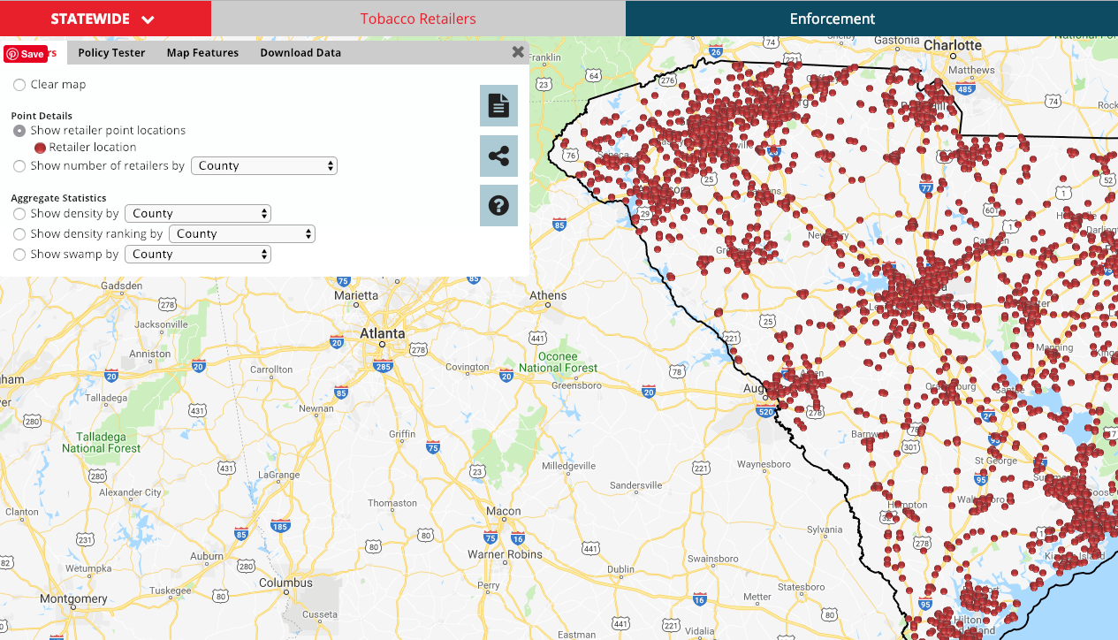
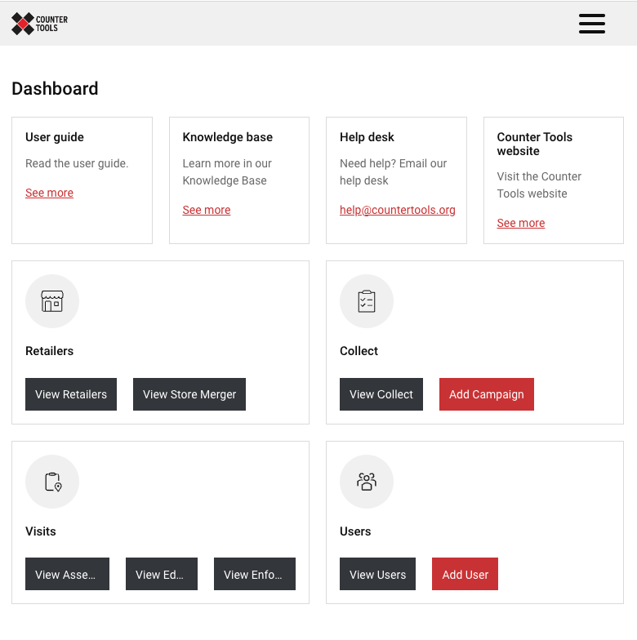
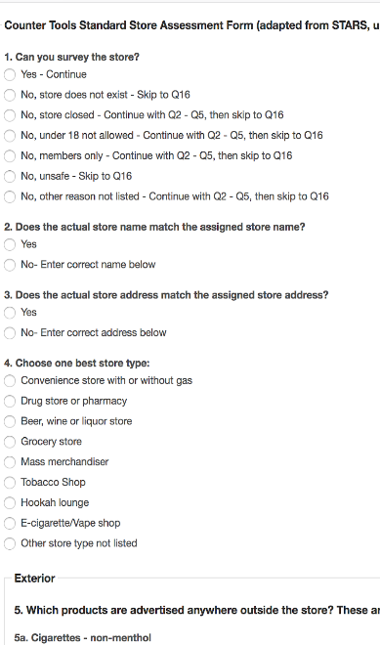
What We Do
We work with our partners to advance place-based public health and health equity through policy, systems, and environmental changes.
Consulting
Training
Storytelling
Providing Tech Tools
Supporting Advocacy Efforts
Disseminating Science and Best Practices

Slide 7
Our Team

Slide 8
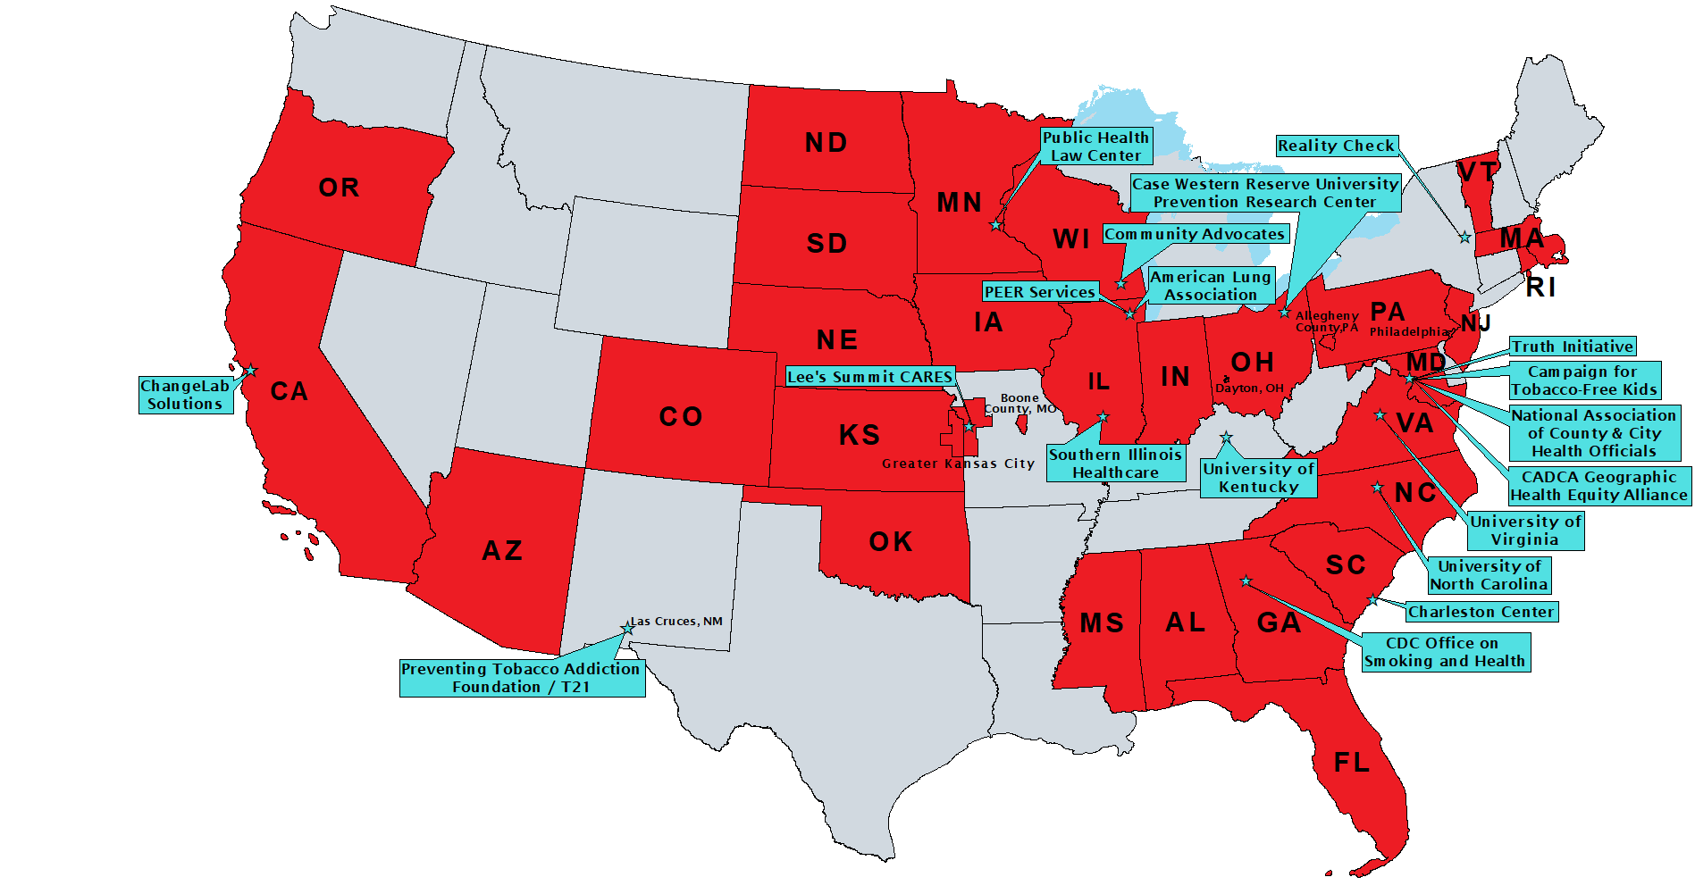
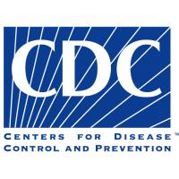
Our Partners

Slide 9
Equity, Diversity, and Inclusion
We define health equity to mean that everyone has a fair and just opportunity to be as healthy as they can be, which means reducing and removing structural barriers and obstacles that apply to and extend beyond the retail environment.
We commit to working alongside our partners towards a more equitable world by addressing equity, diversity, and inclusion in our trainings, providing resources and consultation, sharing relevant data, and supporting advocacy efforts.
Read our full stance on equity, diversity, and inclusion on our website.

Slide 10
Objectives
Illustrate the federal policy landscape for e-cigarettes. Examine practices impacting how and where products are sold as well as how youth access is affected.
Describe how the retail environment impacts youth use of commercial tobacco products, including e-cigarettes, and recognize associated data points.
Identify point-of-sale policy options for preventing youth access, addressing exposure, and preventing nicotine addiction and commercial tobacco-related health impacts.
Explain strategies for promoting education and compliance through local commercial tobacco/vapor product retailer licensing.

Slide 11
Current Landscape
Vast majority of e-cigarettes on the market are being sold illegally
Includes both domestically and internationally manufactured
Includes disposable, prefilled cartridge, refillable/e-liquid
Includes wide variety of flavor types
Robust product displays and promotions remain ubiquitous at brick-and-mortar stores and online sales points.
Gas stations, convenience stores, grocery stores, pharmacies and other all-age accessible locations

Slide 12
Pre-Market Framework
All products are supposed to receive pre-market authorization to be marketed legally
Manufacturers have the onus to prove their products are “appropriate for the protection of the public health”
< 30 product types or accessories have been authorized – mostly tobacco-flavored and one menthol type; 6,000+ can be found in stores nationwide
Millions of applications submitted have overwhelmed the system
Manufacturers marketing products without receiving authorization
Attempting to prolong review period – making minor modifications and resubmitting
Other hinderances:
Addressing claims of synthetic nicotine and agency jurisdiction – April 2022

Slide 13
Limited “Prioritized Enforcement” by FDA in 2020
Certain unauthorized products not prioritized for enforcement – users migrating to these products:
All flavors of “disposable” e-cigarettes – which have become the most commonly-used type among youth
Menthol flavored products – youth migrating from mint
Other exemptions to enforcement:
Flavored e-liquids for refillable tanks or mod systems

Slide 14
Today’s Product Market and Landscape
Unauthorized nicotine products are found in all-age access stores throughout the country
A mixture of domestically and internationally manufactured types
Evading tax regulations and import fees
In a wide variety of youth-appealing flavors, imagery, and promotional language
Unauthorized, lower-cost flavored products – impact on youth access and federal/state/municipal government resources
Product tax levels and compliance vary greatly by product and location
Dramatic increase in nicotine concentration + dramatic decrease in price

Slide 15
Some Recent Key Data Points
2.1 million 8th-12th graders have started using e-cigarettes since September 2021 (NIH, Monitoring the Future, 2024)
E-cigarette use among high school students is nearly twice that of adults (NYTS 2023; MMWR 2023; CDC NCHS 2023)
43% of 15-20 year olds who vaped in 2022 obtained e-cigarettes from retail sources (Truth Initiative, 2024)

Slide 16
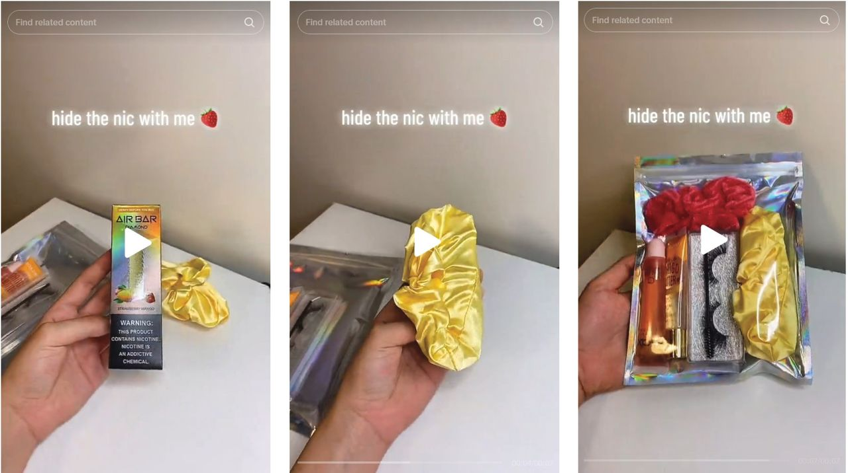
Some Recent Key Data Points
Between 2017 and 2022, disposable e-cigarettes had:
3x greater average nicotine concentration
4x greater average e-liquid capacity
70% decrease in price
(Diaz et al., 2023)
Online Sale - Illegal Practices:
Companies “discreet” shipping methods promoted on social media:
Deceptive/misleading shipping contents declarations (Pearson et al, 2024)
Non-verified/self-certification of age by users (Bertrand et al, 2024)

Slide 17
Point of sale overview

Slide 18
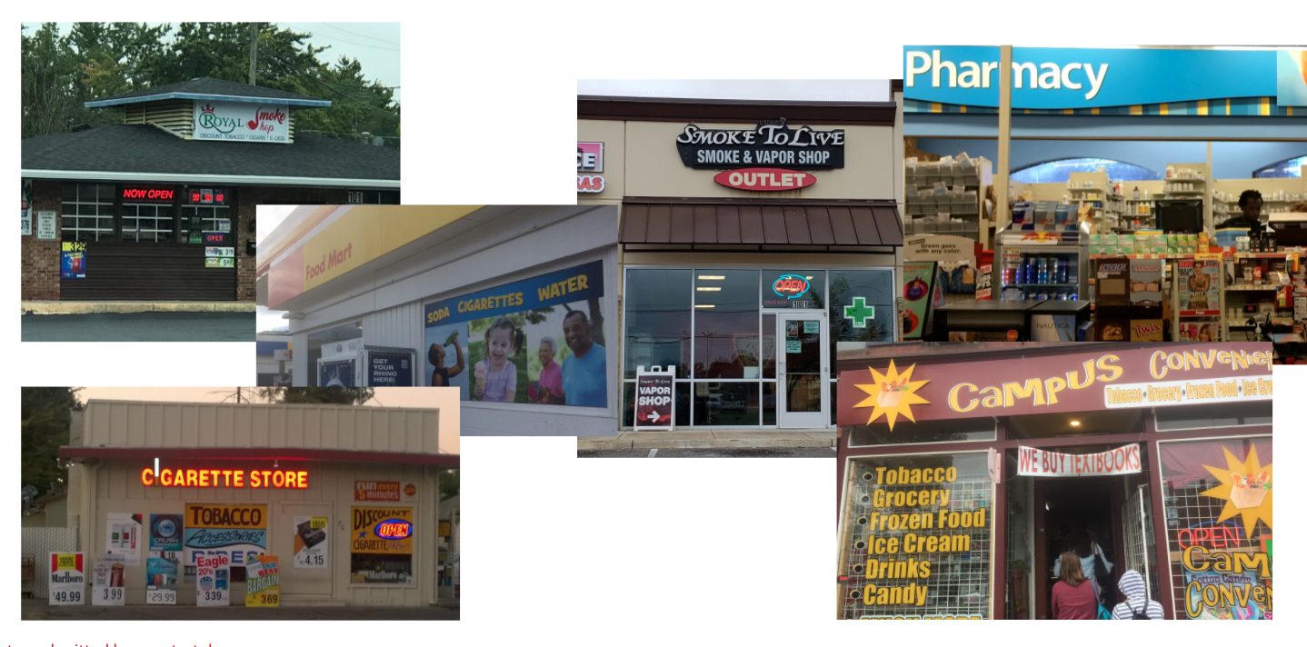
What is the point of sale?
Photos submitted by countertobacco.org users

Slide 19
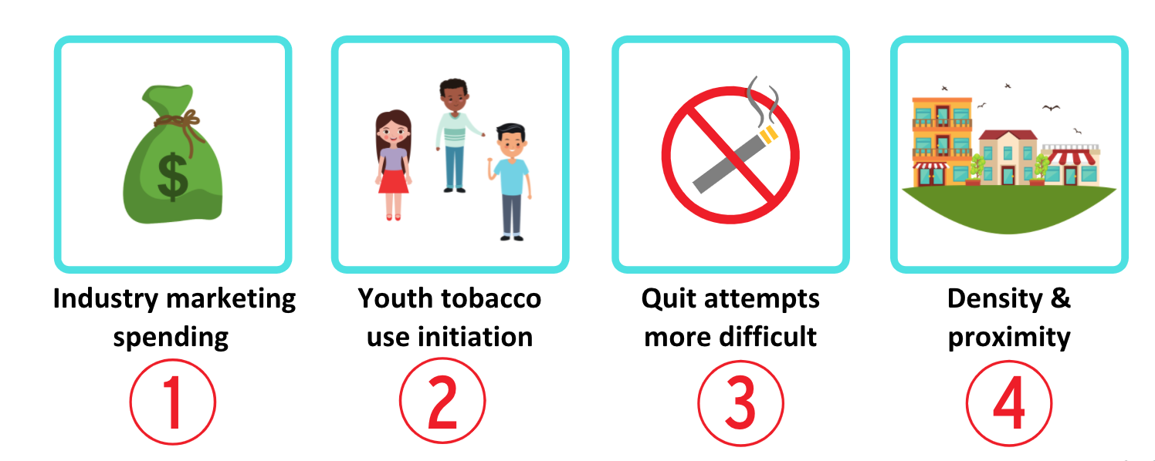
Reasons why POS matters

Slide 20
Working “Upstream”

Slide 21
Explaining the drivers of disparities

Slide 23
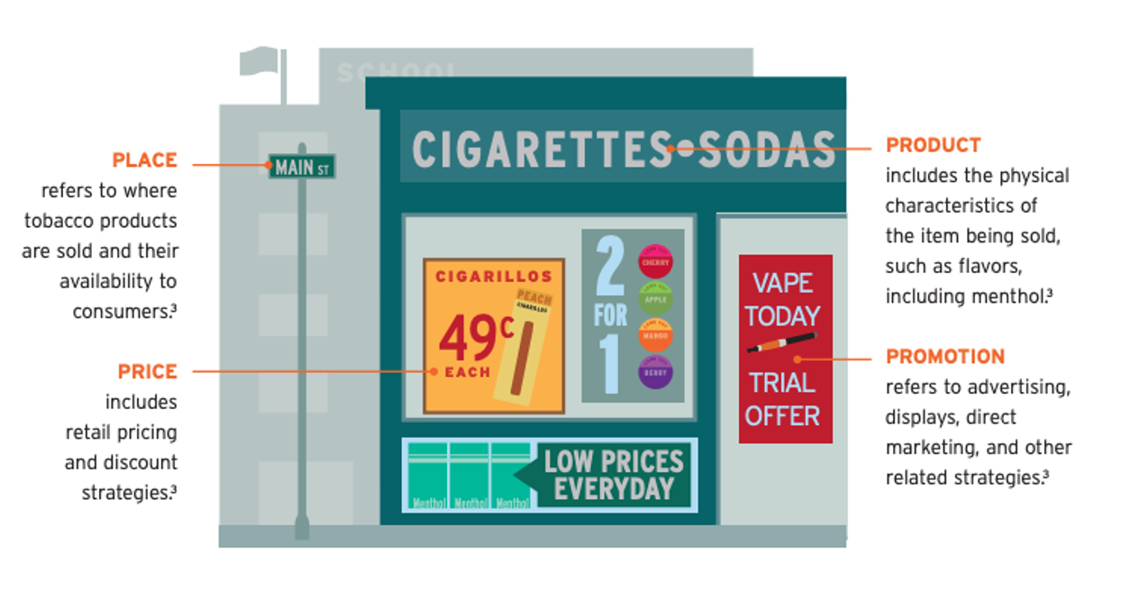
Policy options: the 4 Ps of Marketing

Slide 24
The Retail Environment
Micro retail environment
- Product availability, price, placement, promotion
Macro retail environment
- Number, type, location, and clustering of retailers

Slide 25
Tobacco Industry Marketing
$859.4 million
Spent in 2021 on e-cigarette advertising and promotion
E-Cigarettes
Federal Trade Commission, E-cigarette Report for 2021. (Third Report on E-cigarette Advertising and Sales).

Slide 26
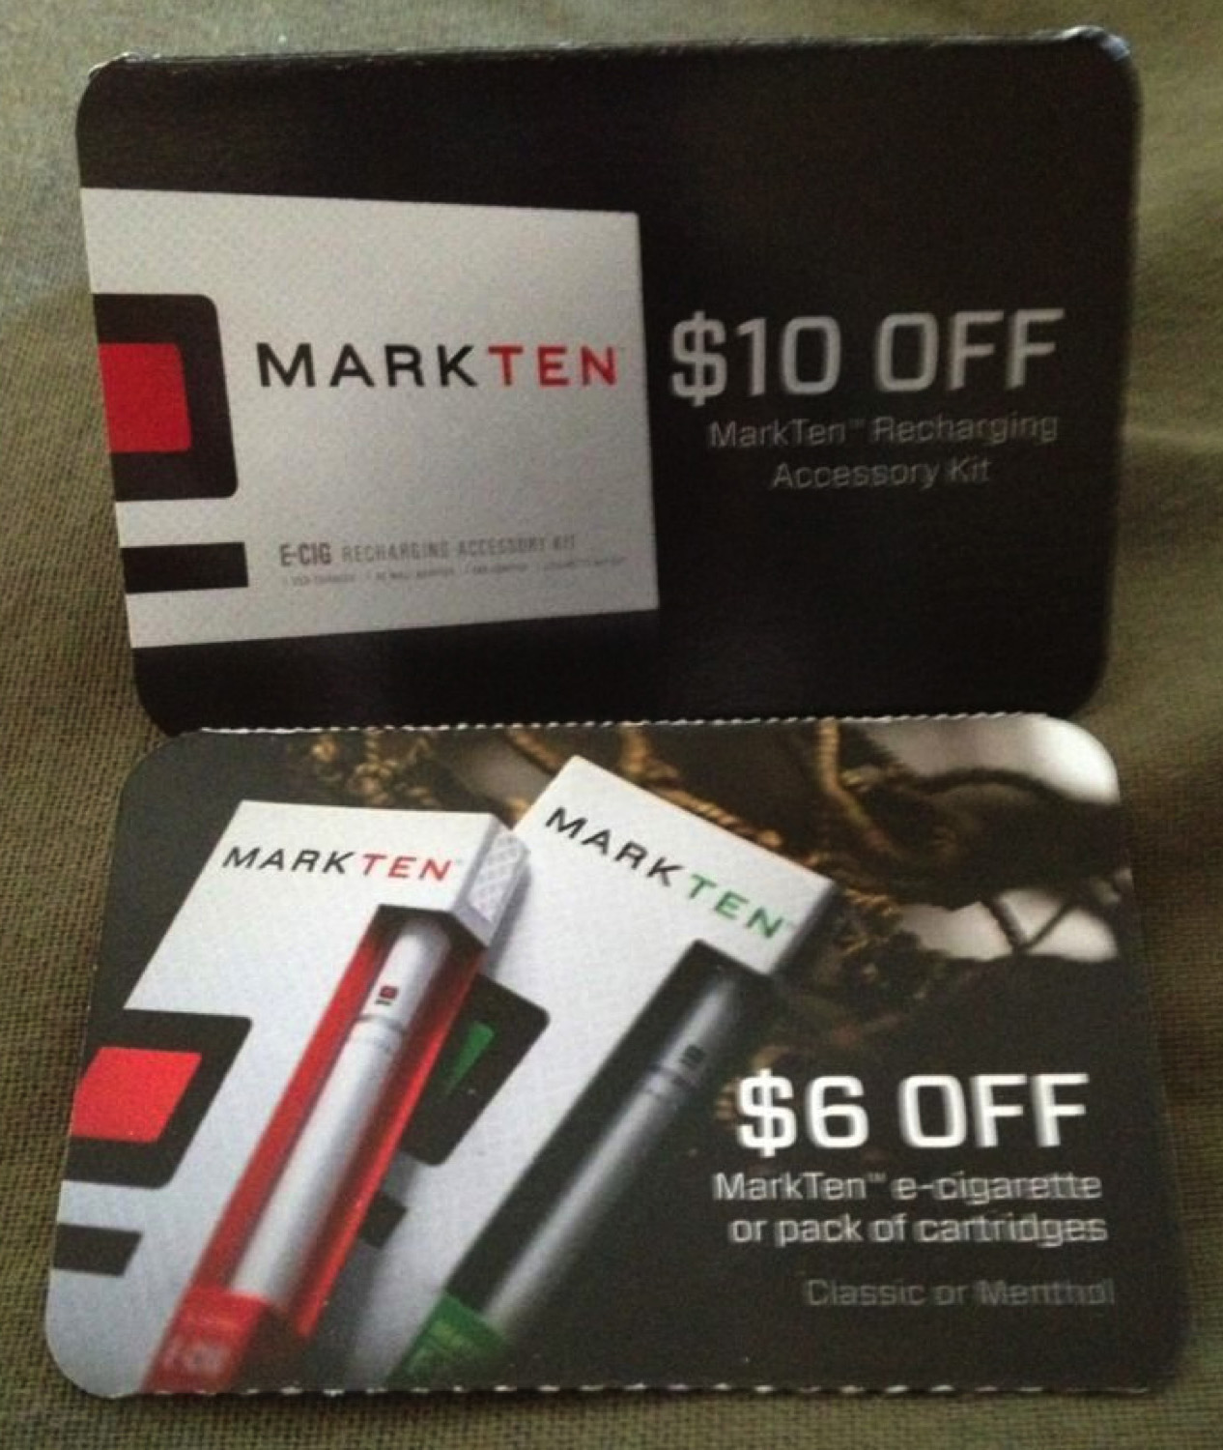
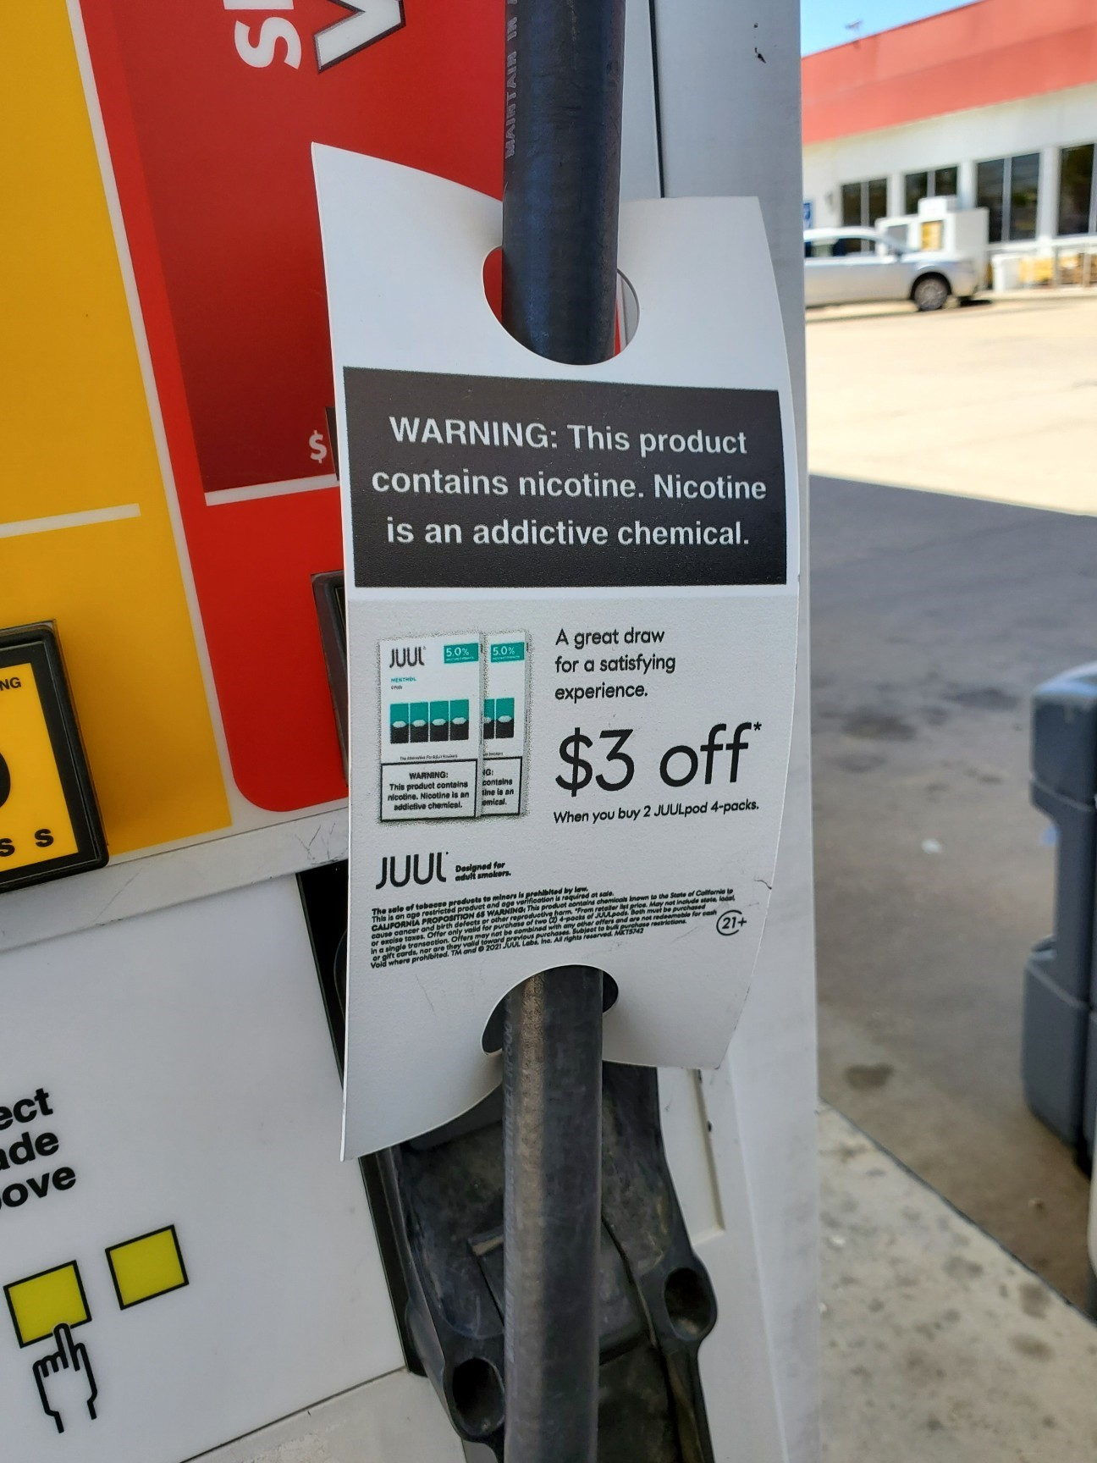
What are they spending on?
Price discounts and promotional allowances
paid to retailers & wholesalers
POS Advertisements (Signs, functional items, displays, shelving units)
Coupons
or Sampling
$533 million
$96.5 million
$86.9 million
Federal Trade Commission, E-cigarette Report for 2021. (Third Report on E-cigarette Advertising and Sales).

Slide 27
The retail store is where tobacco enters your community!

Slide 28
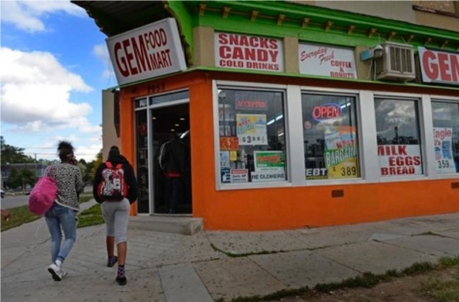
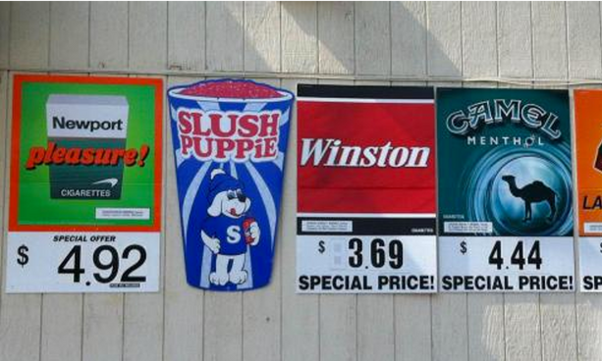
Kids are frequent c-store shoppers
In a nationally representative sample of 13-16 year olds, almost half visit at least once/week
C-stores have more tobacco marketing materials than other store types
Sanders-Jackson, Parikh, Schleicher, Fortmann, & Henriksen, 2015

Slide 29
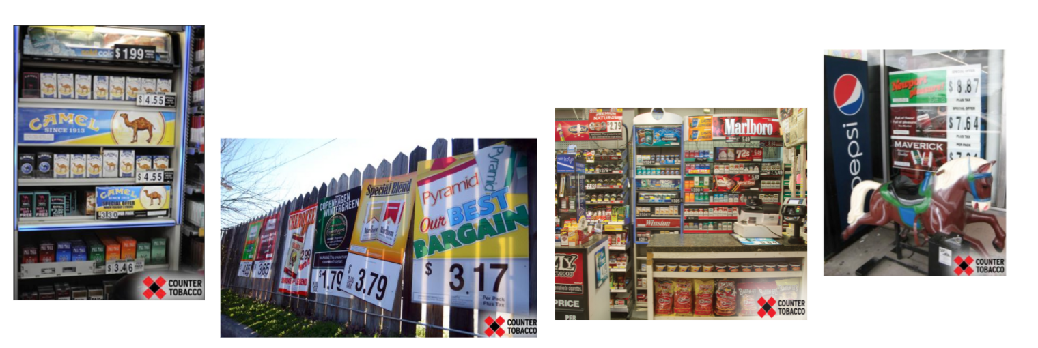
Think about trying to quit in this neighborhood…
Research indicates exposure to retail marketing is associated with impulse purchases & lower probability of quit success

Slide 30
Tobacco Retailer Licensing (TRL) Overview

Slide 31
Why TRL Matters
Provides and maintains a list of tobacco retailers
Reduces tobacco product sales for underage youth
1
2
Prevents youth tobacco use initiation
Can reduce the density, types of, and locations of tobacco retailers
3
4
Funds compliance monitoring programs
Addresses and enforces additional tobacco control strategies
5
6

Slide 32
Tobacco Retailer Licensing (TRL)
Licensing is like the binder that holds other tobacco control policies inside
All tobacco control laws can be enforced through your TRL ordinance

Slide 33
An effective licensing system means…
All retailers (for all tobacco products) must obtain a non-transferable license, renewed annually
Licensing fee covers administrative and enforcement costs
Violating any tobacco control law is a violation of the license
Meaningful penalties: suspension + revocation
Image: hip2save.com
Image: hip2save.com

Slide 34
Local Tobacco Retail Licensing
Most state-level TRL laws managed by agency that focus on tax law, not public health and equity
Local TRL laws make enforcement more effective & efficient
Allows for legislation that is tailored to suit the specific community needs

Slide 35
Connecting the Dots
TRL can help protect youth in our community from the influence of tobacco
# of retailers who have sold to someone underage (underage sales/sales to minors)
# of retailers near schools
Cheap, flavored, youth-appealing products being sold and advertised
Local and state youth tobacco use rates

Slide 36
Why TRL: Key Arguments
Keeps track of who is selling
Protecting youth:
Reduces sales to minors
Reduces youth initiation
Reduces use of cigarettes & e-cigs
Comprehensive enforcement:
Regular visits to EVERY retailer
Meaningful penalties for violations
Allows agencies to prioritize compliance checks with sufficient funding
1. The American Lung Association in California Center for Tobacco Policy and Organizing. Tobacco Retailer Licensing Is Effective, 2013. Available at: http://center4tobaccopolicy.org/wp-content/ uploads/2016/10/Tobacco-Retailer-Licensing-is-EffectiveSeptember-2013.pdf.
2. Forster JL, Murray DM, Wolfson M, Blaine TM, Wagenaar AC, Hennrikus DJ. The effects of community policies to reduce youth access to tobacco. American Journal of Public Health. 1998;88(8):1193-8
3. https://countertobacco.org/resources-tools/stories-from-the-field/retailer-licensing-in-edgewater-colorado/
4. Astor, RL et al. (2019). Tobacco Retailer Licensing and Youth Product Use. Pediatrics, 143 (2)

Slide 37
Why TRL: Youth Protection
Reduces sales to minors
Decrease by avg. of 26% in CA jurisdictions w/ strong TRLs¹
Decrease from 39% to 5% in MN communities²
Decrease of 76% in CO communities³
Reduces youth initiation & use of cigarettes & e-cigs
Over 6 months, youth in communities with strong TRLs were
33% less likely to have initiated cigarette use;
26% less likely to have initiated e-cigarette use;
55% less likely have become a current e-cigarette user⁴
1. The American Lung Association in California Center for Tobacco Policy and Organizing. Tobacco Retailer Licensing Is Effective, 2013. Available at: http://center4tobaccopolicy.org/wp-content/ uploads/2016/10/Tobacco-Retailer-Licensing-is-EffectiveSeptember-2013.pdf.
2. Forster JL, Murray DM, Wolfson M, Blaine TM, Wagenaar AC, Hennrikus DJ. The effects of community policies to reduce youth access to tobacco. American Journal of Public Health. 1998;88(8):1193-8
3. https://countertobacco.org/resources-tools/stories-from-the-field/retailer-licensing-in-edgewater-colorado/
4. Astor, RL et al. (2019). Tobacco Retailer Licensing and Youth Product Use. Pediatrics, 143 (2)

Slide 38
Tobacco Retailer Licensing
Key Considerations
Defines what types of products are included, i.e., provides a comprehensive definition of “tobacco products” (or other terminology) for all known and future types (cigarettes, cigars, smokeless tobacco, pipes, rolling papers, electronic smoking devices, nicotine products, related liquids and other related devices etc.)
Ensures that penalties are imposed on the tobacco retailer or licensee and not the youth purchaser or non-management employee—no Purchase, Use and Possession (PUP) language
Mandates a minimum number of unannounced compliance checks be conducted for each licensed retailer every year
Image: hip2save.com
Image: hip2save.com

Slide 39
Defining Success
Some ideas:
Retailers feel confident in understanding the laws due to regular merchant education and have a deepened relationship with local agencies
Retailers are held accountable
Decreased sales to minors over time
Plug-ins are added to address issues of concern in your community and to ultimately decrease the influence of harmful tobacco products

Slide 40
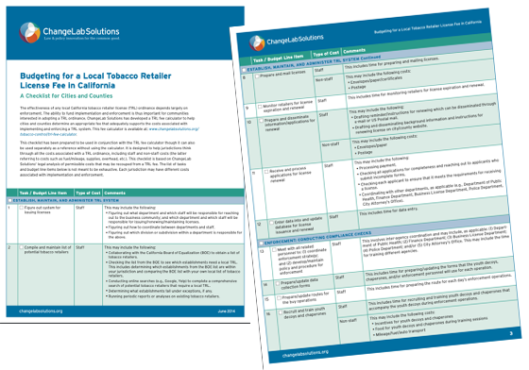
Resource #1
ChangeLab Solutions TRL Fee & Budgeting Checklist

Slide 41
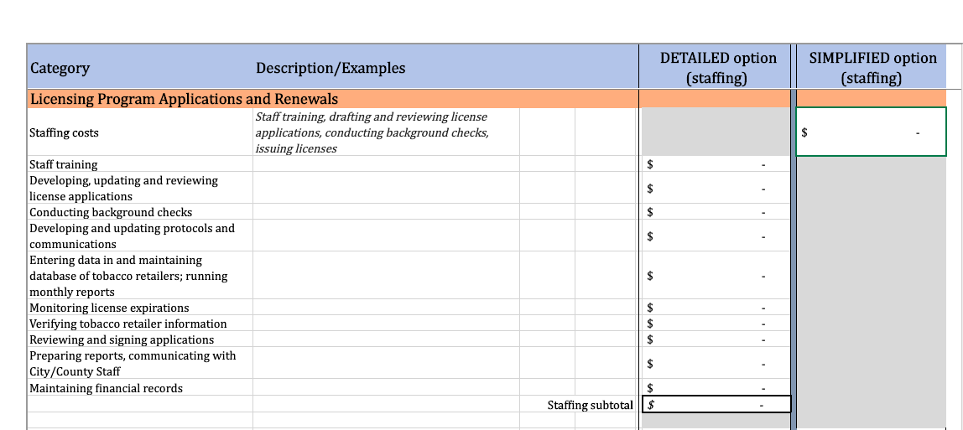
Resource #2
Public Health Law Center TRL Calculator

Slide 42
“Plug-ins” – Policies regulating licensure and sales at state or local level

Slide 43
“Plug in” Considerations
This we know:
Exposure to POS tobacco
Retail marketing
Price promotions;
Product displays and advertisements;
Tobacco use initiation
Tobacco use maintenance
Difficulty quitting
Theoretically, then:
Exposure to POS tobacco
Price promotions;
Product displays and advertisements;
Retail marketing
Less tobacco use
Easier to quit

Slide 44
TRL Plug-in Options
WHO?
Tobacco 21
WHAT?
Require licenses for “tobacco products”, “Nicotine dispensing devices” and “nicotine products”
Restrictions on the sale of menthol and other flavors
Restrictions on imitation tobacco products (e.g. candy cigarettes, beef jerky chew)
WHERE?
Restrict by retailer type (e.g. no pharmacies can sell, no moveable locations)
Restrict by retailer location (e.g. proximity restrictions)
Density restrictions (e.g. retailer caps)
HOW (MUCH)?
Set minimum pricing
Prohibit discounts and coupons
Set signage limits (content neutral)
Prohibit self-service and free samples

Slide 45
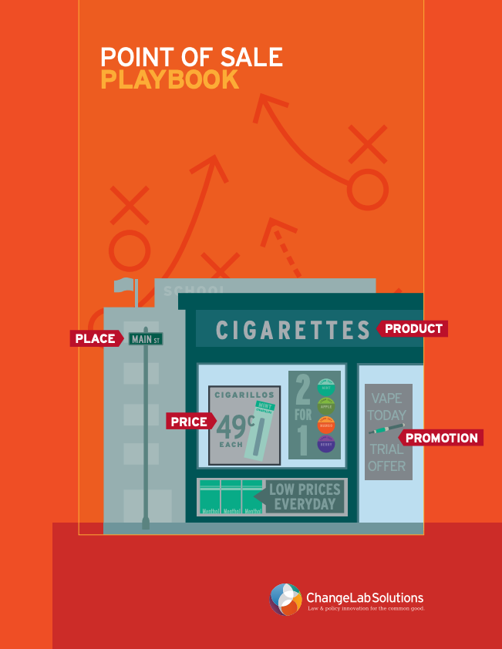
”Plug in” Options: Consider the 4 ‘P’s
Image from ChangeLab Solutions’ POS Playbook: http://www.changelabsolutions.org/sites/default/files/Point_of_Sale_Playbook_FINAL_20160105.pdf

Slide 46
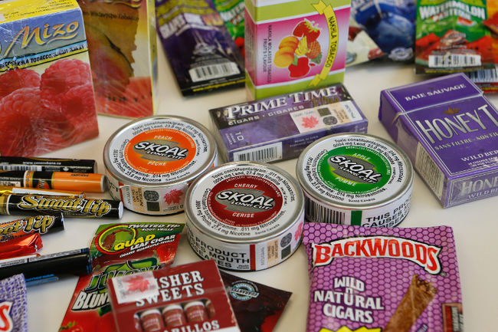
Flavored Tobacco Sales Restrictions
Evidence-based strategy to reduce youth initiation
Including menthol important for health equity
Options include:
Comprehensive ban
Restrict by place sold
Restrict by product type
Restrict within certain distance of schools (proximity)
Farley, S. M., & Johns, M. (2016). New York City flavoured tobacco product sales ban evaluation. Tobacco control, tobaccocontrol-2015.

Slide 47
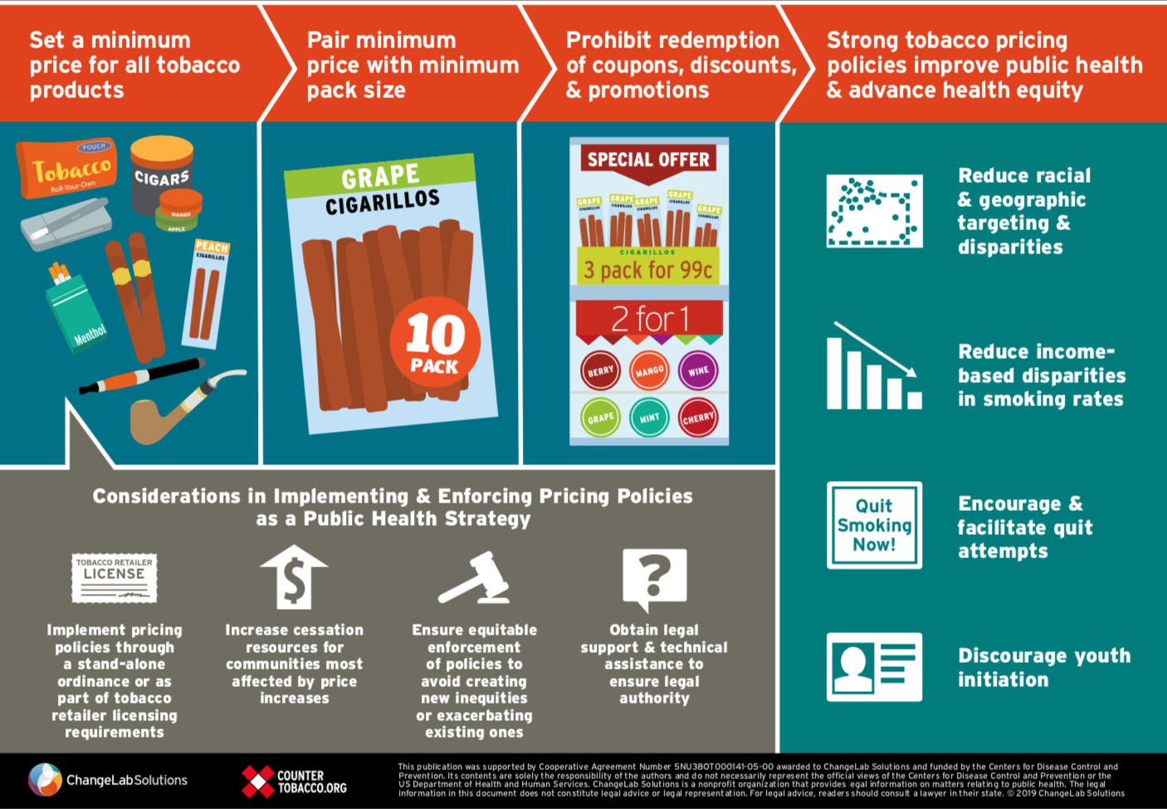
Price Increases
One of the most effective strategies for reducing initiation, decreasing consumption, & increasing cessation

Slide 48
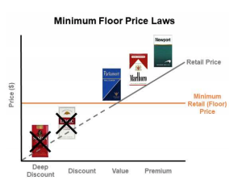
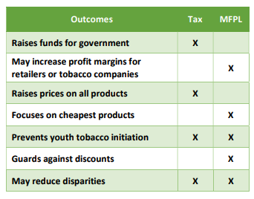
Minimum Floor Pricing Laws
Sometimes more feasible to implement than other pricing policies
Potential for major equity impact when paired with cessation services

Slide 49
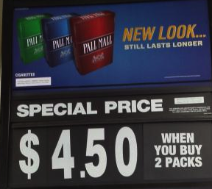
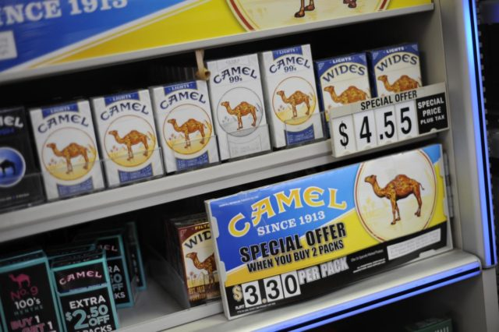
Restricting coupon redemption & discounts
Coupons and discounts often counteract excise tax increases
Price discounts single largest industry expenditure
NY, NJ, and RI have statewide bans

Slide 50
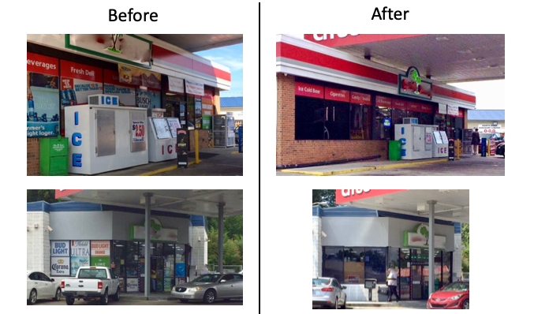
Content Neutral Advertising
Restricts ALL ads without regard to content
Impacts ads for all products (e.g., alcohol, food, toys, etc.)
May involve limiting percentage of window space or the size of ads allowed
Generally seen as most legally feasible option for restricting tobacco ads

Slide 51
Density & Proximity - Zoning

Slide 52
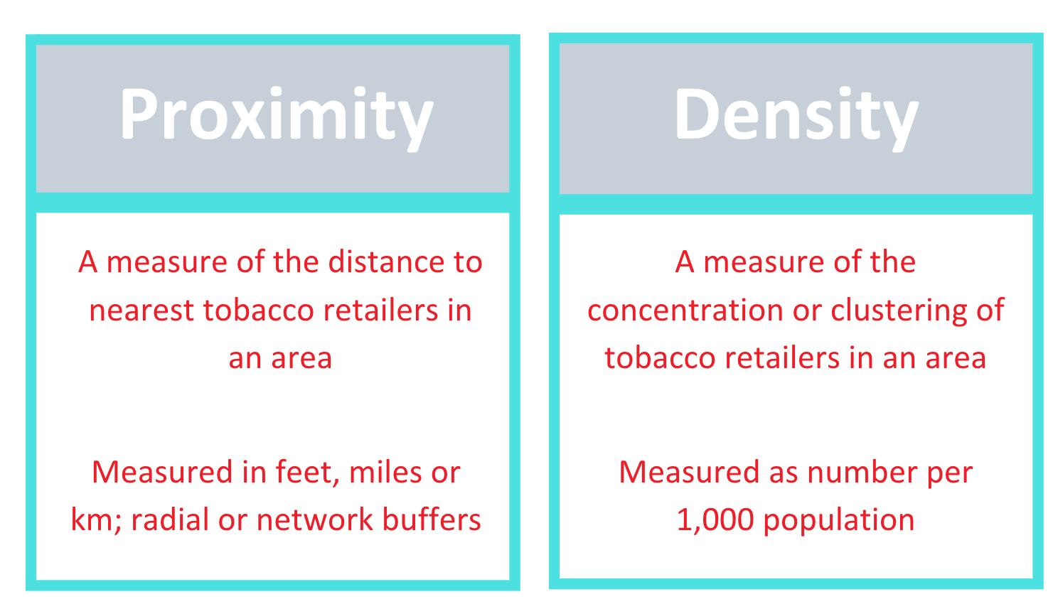
Retailer Density & Proximity

Slide 53
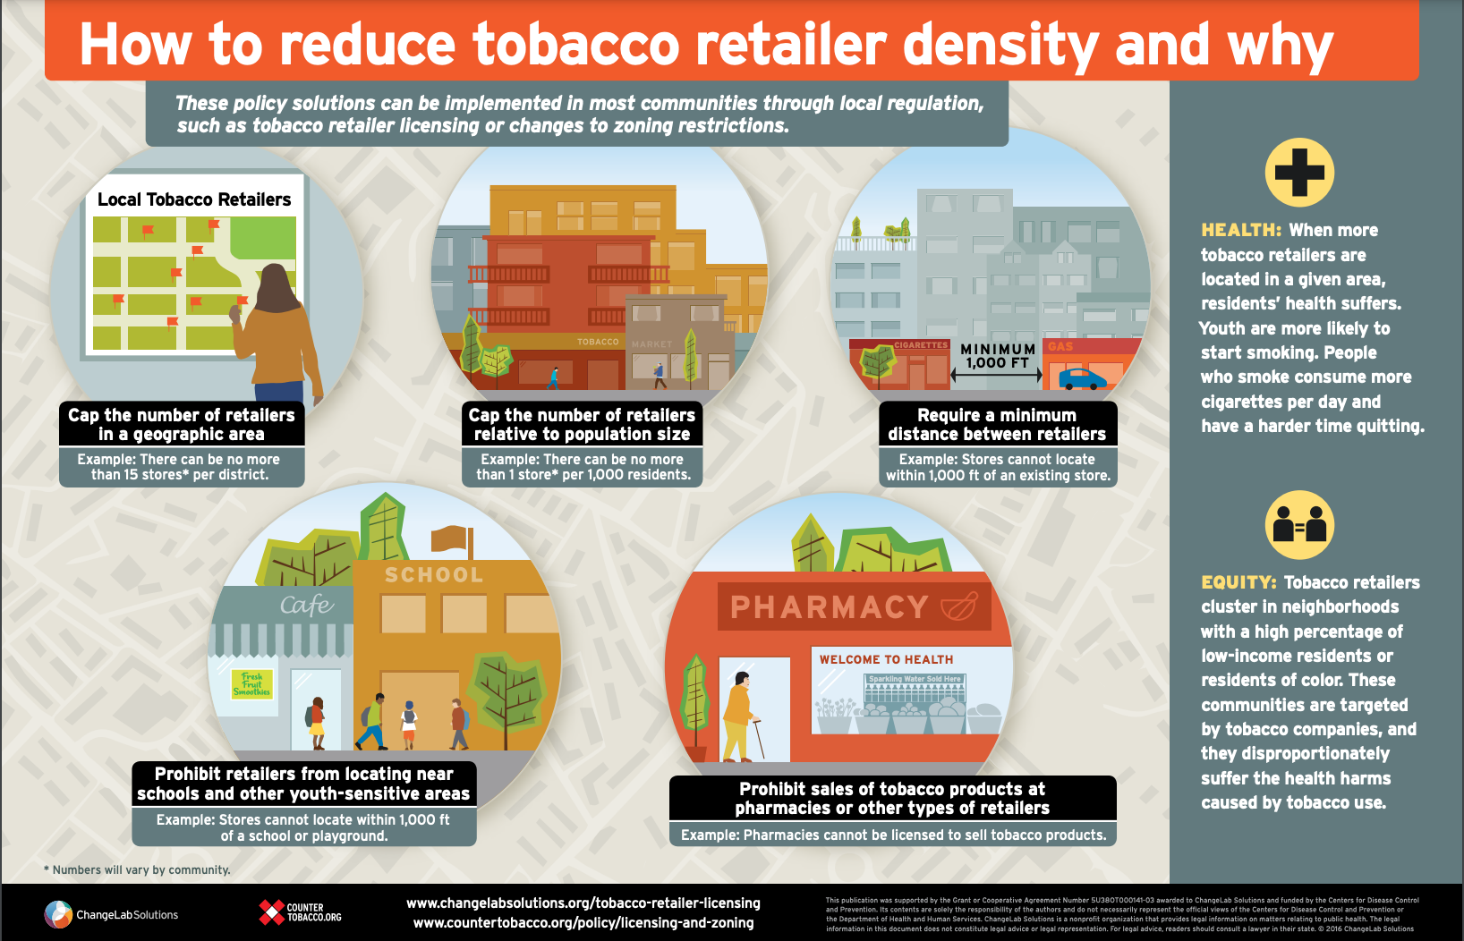
Density & Proximity Restrictions

Slide 54
Why Retailer Density Matters
When more tobacco retailers are located in a given area:
Residents’ health suffers
Youth are more likely to start smoking
People who smoke consume more cigarettes per day
People who smoke have a harder time quitting
Tobacco retailers cluster in neighborhoods with a high percentage of low-income residents and residents of color. These communities are targeted by tobacco companies, and they disproportionately suffer the health harms caused by tobacco use
http://countertobacco.org/wp-content/uploads/2017/03/Tobacco_Retailer_Licensing_Density-Infographic_FINAL_20170202.pdf

Slide 55
Density near where Youth live
“This review found the density of TROs [tobacco retail outlets] around the home, and to an extent schools, are the most strongly associated with youth smoking outcomes. …Rather than policy options which target a specific area or type of store, this review suggests that policy options which reduce the overall density of TROs in a neighbourhood, would contribute to reducing smoking rates among youth.”
Marsh et al. (2021). Association between density and proximity of tobacco retail outlets with smoking: A systematic review of youth studies, Health Place. doi:10.1016/j.healthplace.2019.102275.

Slide 56
Density near Youth Activity Spaces
Time spent near tobacco outlets
Exposure to peers who use tobacco
Daily tobacco use
Any space where youth spend time is a place where they may be influenced
It may be beneficial to consider regulating retailers near other youth-oriented spaces and residential areas in addition to near school
Kowitt & Lipperman-Kreda (2020) Nicotine & Tobacco Research doi: 10.1093/ntr/ntz088

Slide 57
One size does not fit all

Slide 58
Equity considerations
Commercial tobacco control laws and policies are public health measures
Eliminate youth “PUP” laws and criminal penalties
Hold businesses and industry actors accountable
https://countertobacco.org/wp-content/uploads/2020/10/Tobacco-Control-Enforcement-for-Racial-Equity.pdf

Slide 59
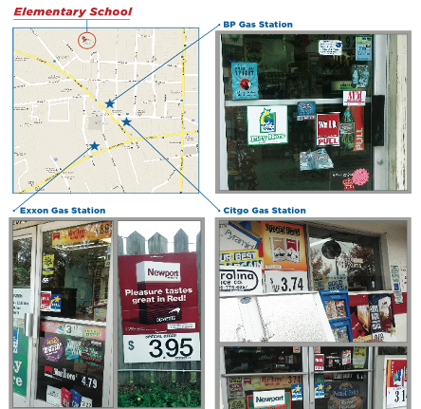
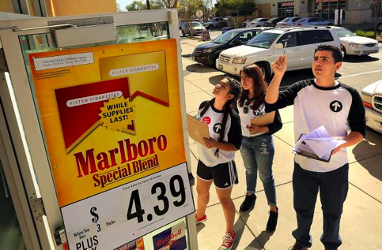
Data-Driven

Slide 60
Contact Information
Stay in touch!
jacob@countertools.org
CounterTools.org
CounterTobacco.org
bit.ly/CounterToolsNewsletter
bit.ly/CounterTobaccoNews
Facebook.com/CounterToolsNC
Facebook.com/CounterTobacco
@CounterTools
@CounterTobacco
LinkedIn.com/company/Counter-Tools
Notes:
60

